Slide 1
The Third Phase of Workshop Series on The Effects of Climate Change on the Indian Ocean Marine Environment
The long-term variability of meteorological parameters over the Indian Ocean
Parvin Ghafarian
Iranian National Institute for Oceanography and Atmospheric Scince(INIOAS)
20 Febuary 2023
p.ghafarian@inio.ac.ir

Slide 2
Outline
Climate of the Indian Ocean and Climate change forcing
Data and methods
The long-term variability of meteorological parameters over the Indian Ocean
Signature of the Climate Change in the northern Part of the Indian Ocean
Marine Weather Hazards
Future work

Slide 3
Indian Ocean climate
The Indian Ocean basin can be subdivided into four general climatic regions based on atmospheric circulation:
monsoon,
trade winds,
subtropical and temperate zone,
and subantarctic and Antarctic zone

Slide 4
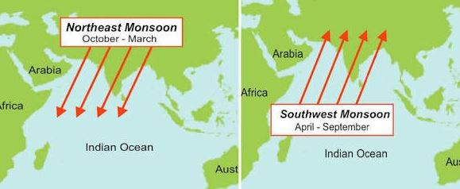
Monsoon

Slide 5
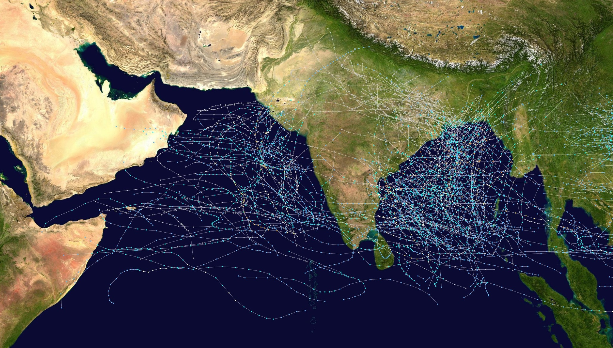
Cumulative track map of all North Indian Ocean cyclones from 1970 to 2005

Slide 6
Climate Change Forcing

Slide 7
Data
Observation Data
Synoptic stations
Buoy
Reanalysis Data
ECMWF
NCEP/NCAR
Analysis Data
GFS
FNl
Satellite Data
AVHRR (SST)
QuikSCAt, Blended sea winds,
Radar Data
Persian Gulf explorer data

Slide 8
Methods
Monitoring
Statistical Analysis
Synoptic Analysis
Numerical Simulation

Slide 9
The long-term variability of meteorological parameters over the Indian Ocean

Slide 10
The long-term variability of meteorological parameters over the Indian Ocean

Slide 11
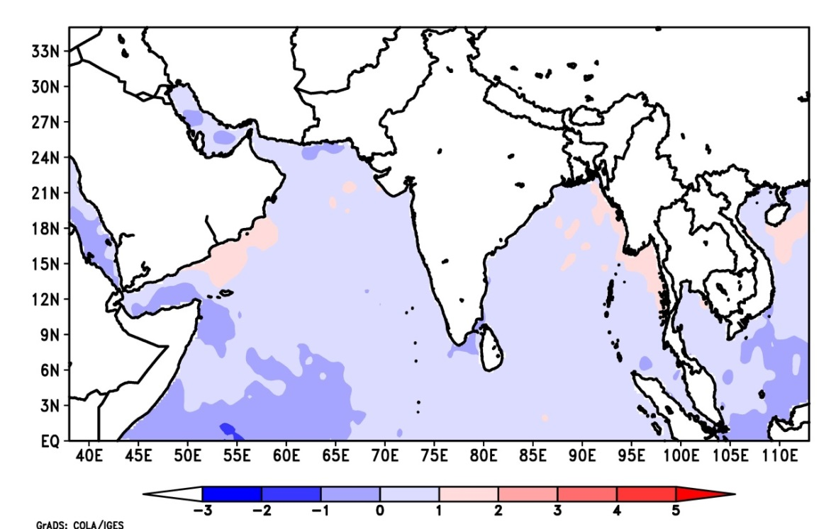
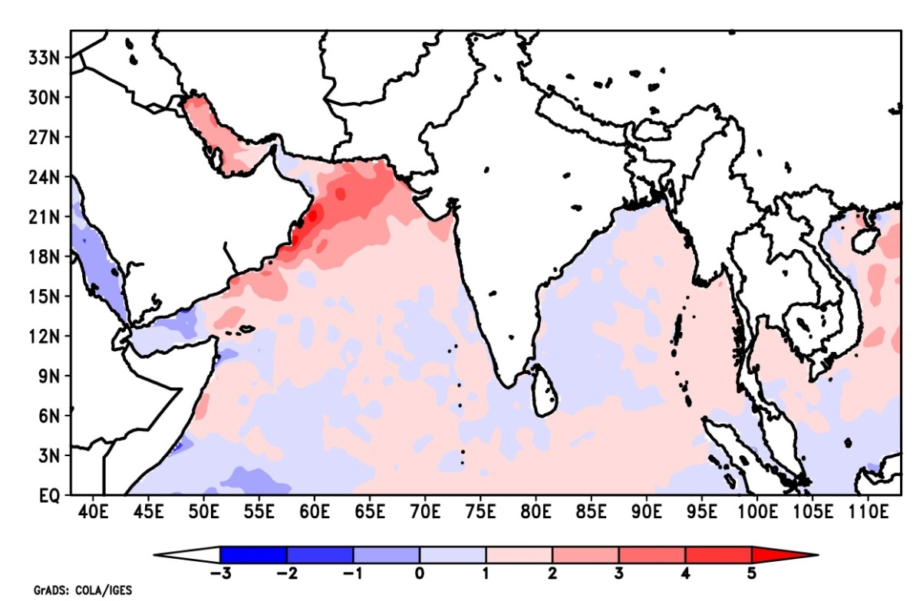
Sea Surface temperature anomaly
Jul-1979
Jul -2020

Slide 12
Signature of the Climate Change in the Persian Gulf

Slide 13
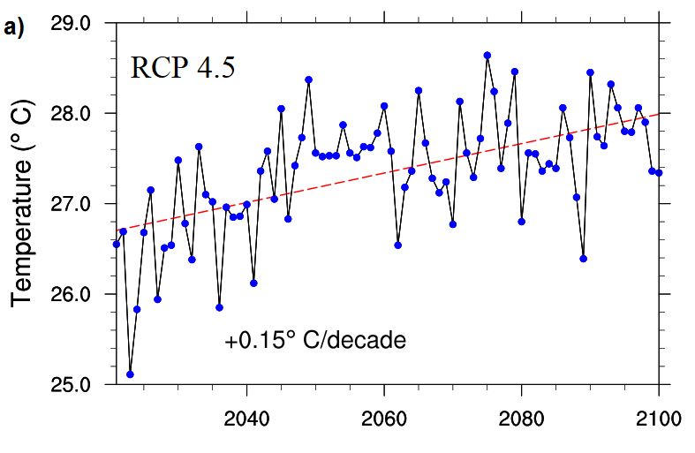
Temperature projection

Slide 14
Marine-Weather Hazards in the North of the Persian Gulf
Floods
Drought
Convective storms
Wind storms
Waterspout
Meteotsunami
Dust
Tropical storm

Slide 15
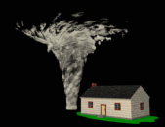
water spout

Slide 16
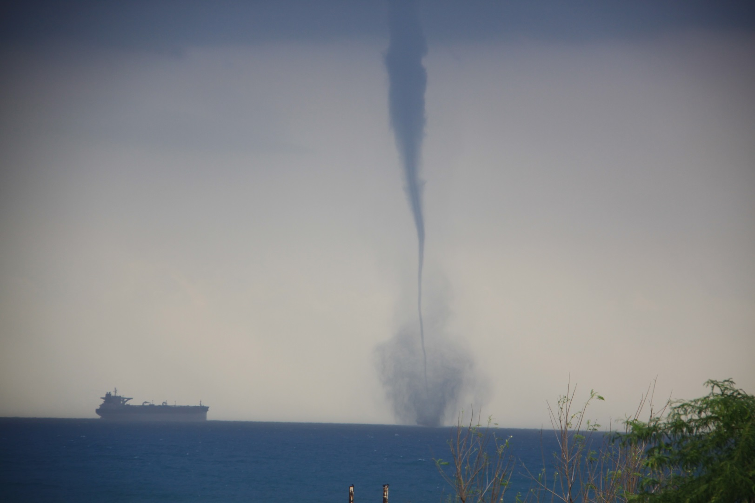
Waterspout in the Khark Island

Slide 17
Wind pattern from Bushehr radar

Slide 18
Frequency of dust events over NW of the Persian Gulf

Slide 21
Meteotsunami

Slide 22
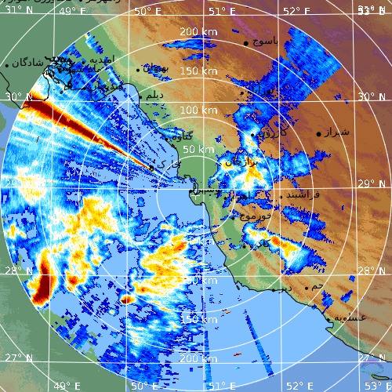
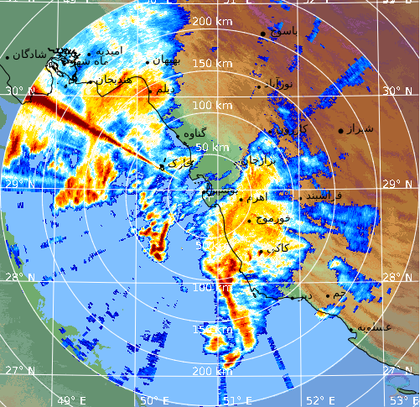
Surface Rainfall Intensity: SRI (dBR), Bushehr radar
00:00 UTC
04:00 UTC
19 March 2017

Slide 24
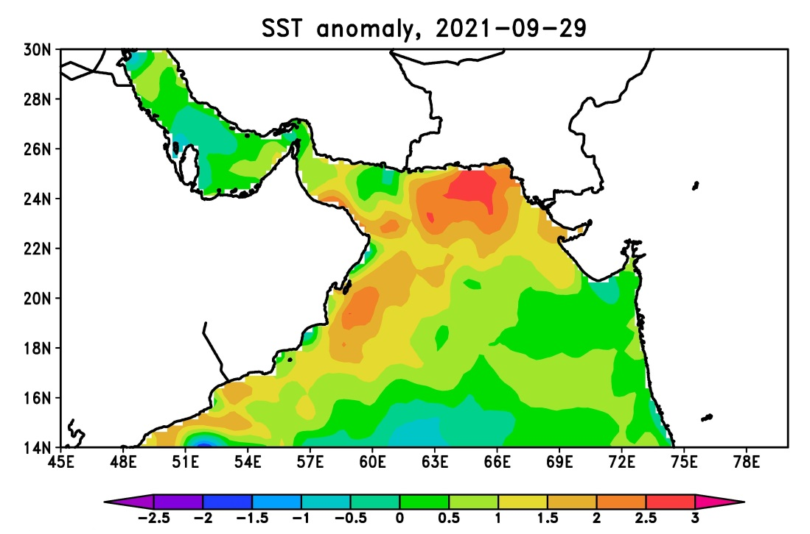

Slide 25
publications
https://link.springer.com/article/10.1007/s40722-022-00273-8
https://www.sciencedirect.com/science/article/abs/pii/S2352485522000494
https://www.sciencedirect.com/science/article/abs/pii/S1309104222000435
https://link.springer.com/article/10.1007/s11069-020-04208-0

Slide 26
Future Work
Development of the monitoring network
Sharing data
Enhance Numerical model
Establishment Early Warning system

Slide 27
Thanks for your attention

