Slide 1


Slide 2
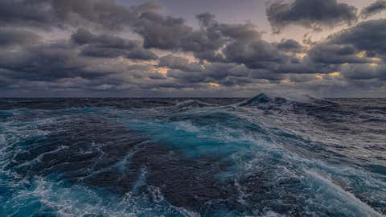
paleoenvironmental reconstruction of southeastern Iran: how variability in the Indian Ocean Summer Monsoon contributes to paleoclimatic changes in West Asia?
Alireza Vaezi
Research Institute for Earth Sciences, Geological Survey of Iran

Slide 3

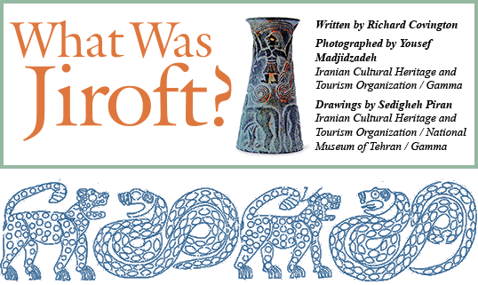
Topics
Jiroft - an Early to Late Bronze Age settlement
The paradigms and puzzles
Multi-proxy data of past changes (Jazmurian playa, Konar Sandal)

Slide 4
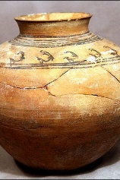
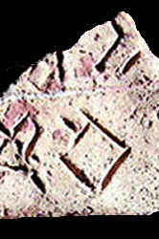
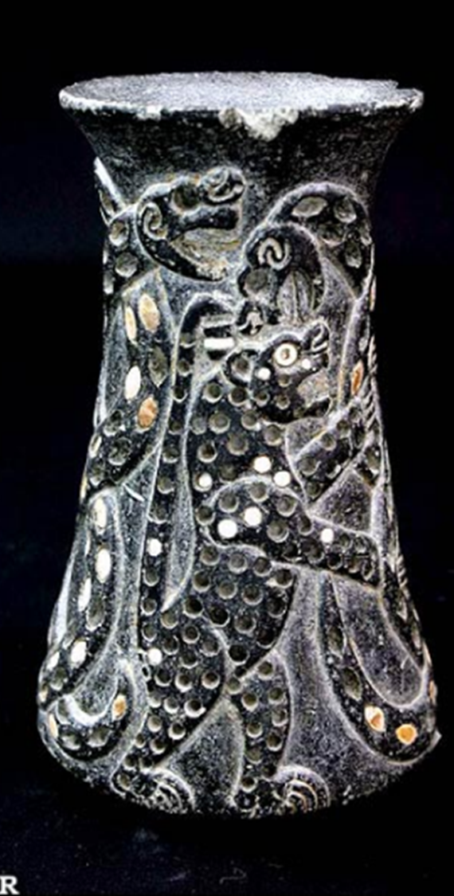
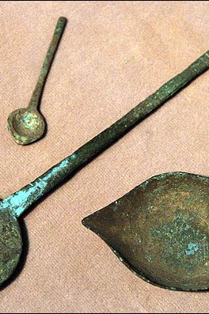
Highlights (Who is first---some controversy)
Settlement vs. Civilization
Jiroft was a large urban center that was advanced
Significant advancement in making pottery, bronze appliances, buildings and agriculture
Trade links with Sumer and Harappa (cultural artifacts)
Discovery of tablets with pre-Elamic script – the earliest forms of writing!!
It is proposed that Jiroft was an agricultural society that predates Mesopotamia (???)

Slide 5
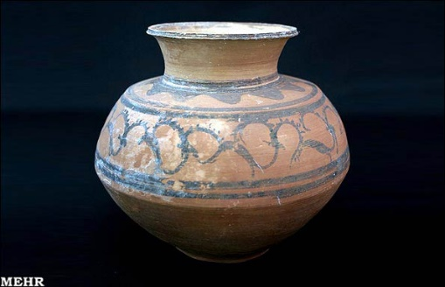
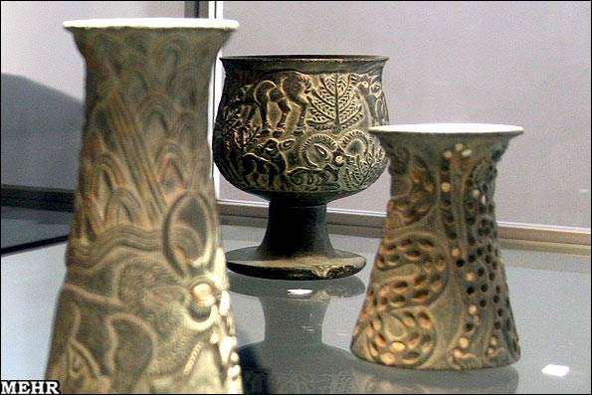
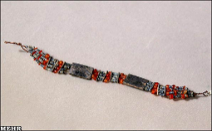
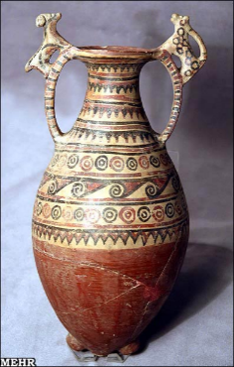
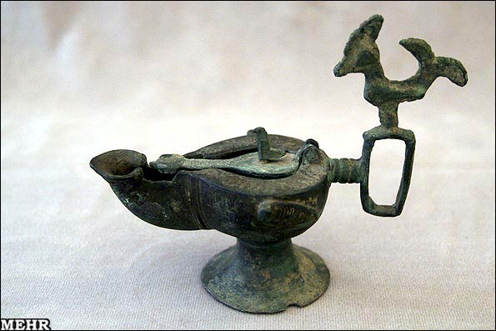
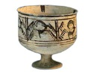
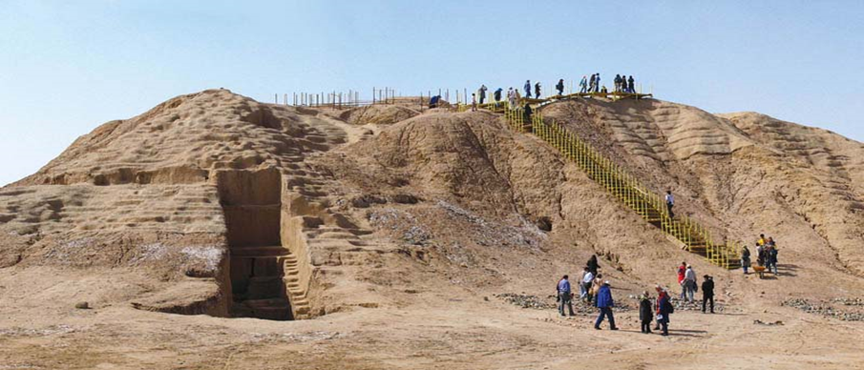
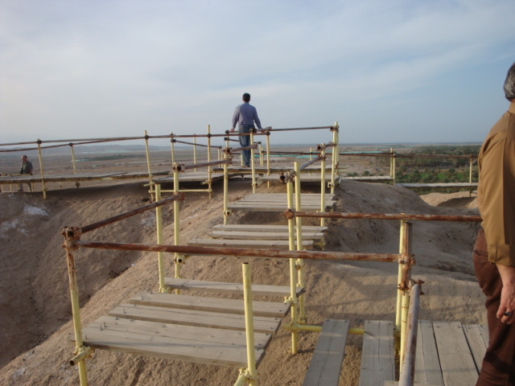
Konar Sandal, North mound (Jiroft)

Slide 6
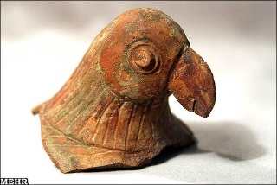
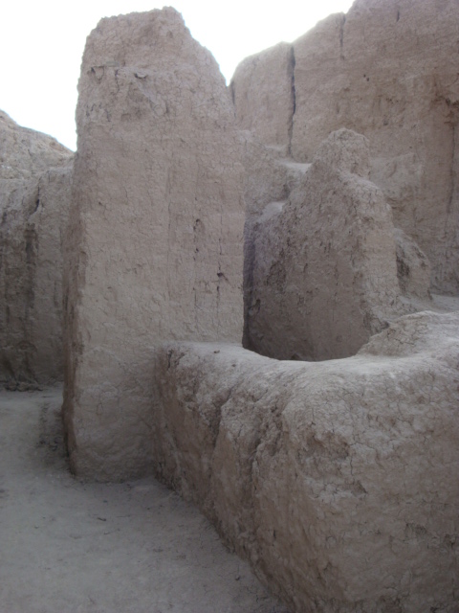
The Puzzle
Jiroft undergoes a decline c. 2500 yrs BC for reasons that are not well-defined. The settlement collapsed.
Archeologists suggest
nomadic invasions, pestilence, or weak succession
The ceremonial graves, intact urban settlements state otherwise – the change was not as dramatic as suggested but happened more gradually
What triggered this collapse?

Slide 7
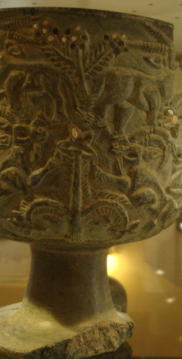
Highlights
Some interesting things happening in the neighborhood
Decline in Mesopotamia related to climate change (Weiss et al. 1993, Science)
Decline in Harappa that has been related to climate change (Dixit et al. 2015, EPSL; Sarkar et al. 2016, Nature)
Weakening of monsoons in Oman and North Africa (Fleitmann et al 2004, QSR)
Droughts and wet periods in Assyria (Sinha et al. 2019, Science)
Reports of early Holocene climate change in northern Iran (Sharifi et al. 2016, QSR)

Slide 8
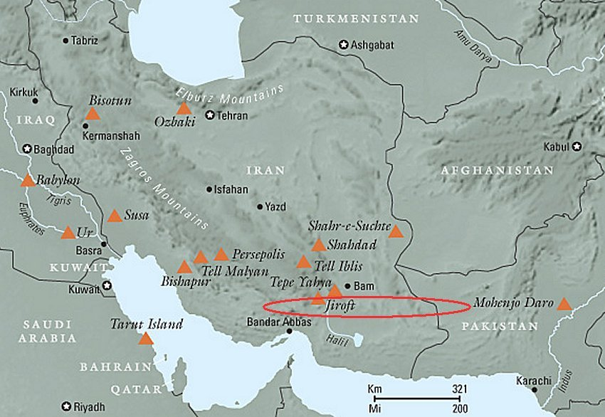
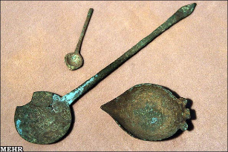
Hypothesis
Climatic changes swept through the region spread over 3000 km from late Pleistocene onwards
Jiroft’s decline perhaps coincides with climatic changes
Perhaps a more regional phenomenon unfolded vs. what the archeologists propose?

Slide 9
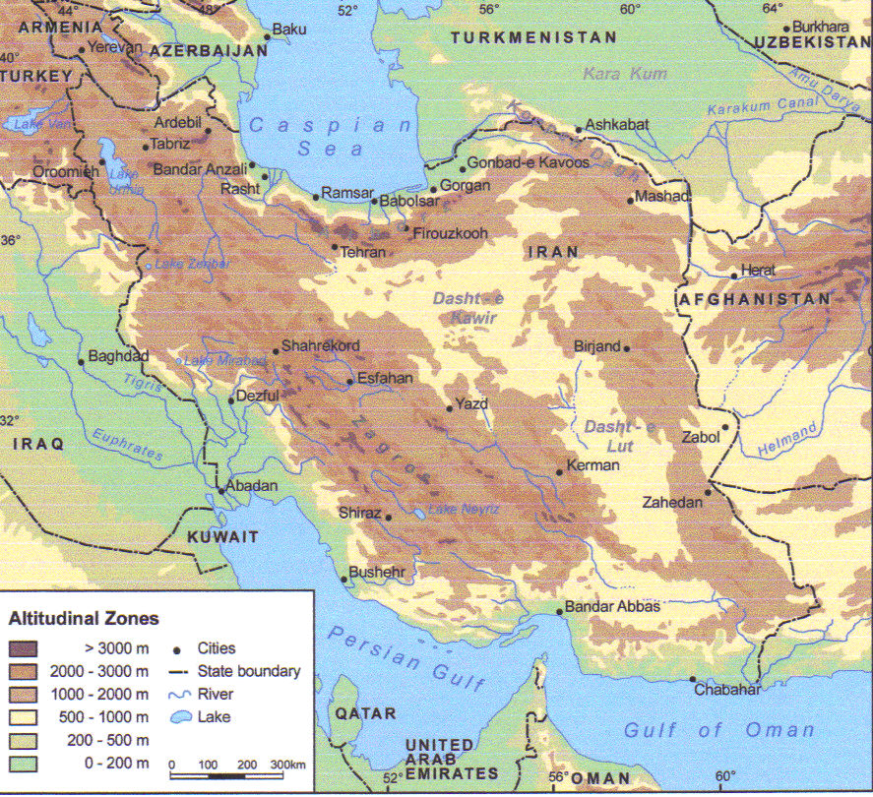

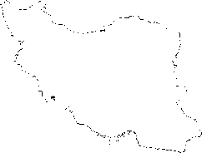

Shahr-e Sokhta
Teheran
Iran
Konar Sandal
Konar Sandal and Shahr-e sokteh (Early Bronze Age settlements) saddled between Mediterranean winter rain and sub-tropical desert climate
Position of ITCZ pre-Holocene (-----) and present-day position (___)???

Slide 10
A Great Project
paleolimnological records from Lake Jazmurian: Climate-culture evolution at Jiroft in southeast Iran during the Holocene
The project was supported from grants provided by Vetenskapsrådet to JR (Grant E0402601).
Sweden: Linköping Univ,
Research Institute for Earth Sciences, Geological Survey of Iran,
Tehran University,
INIOAS,
France: Natural History Museum, Univ Aix-Marsielles
USA: University of Florida

Slide 11


Shahr-e Sokhta
Teheran
Iran
Konar Sandal
Jazmurian
  Lake Jazmurian - a playa (5 m; c. 21000 yrs)
  Konar Sandal - a peat deposit between the citadels in (2.5 m; c. 4000 yr)
  Shahr-e sokteh (6 m; c. 15800 yrs)

Slide 12
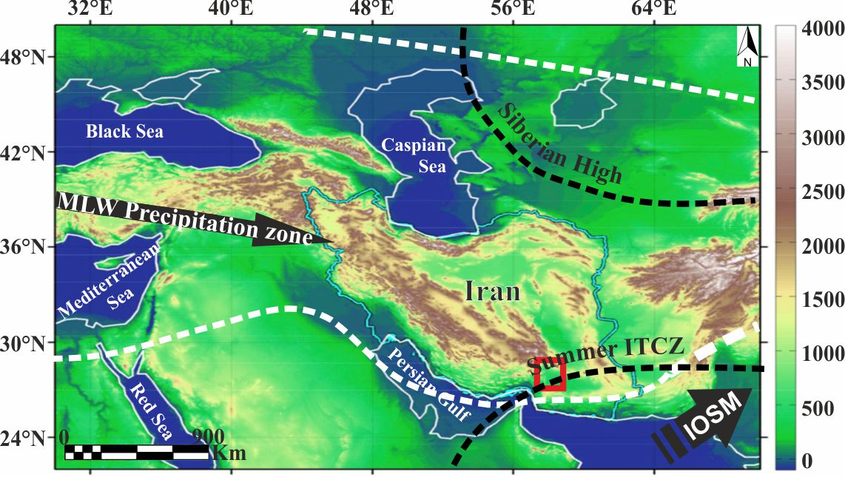
Jazmurian Playa
The hydro-climate of the Iranian Plateau is controlled by complex interactions between the Mid-Latitude Westerlies (MLW), the southwest Indian Ocean Summer Monsoon (IOSM), and the northeast Siberian Anticyclone

Slide 13
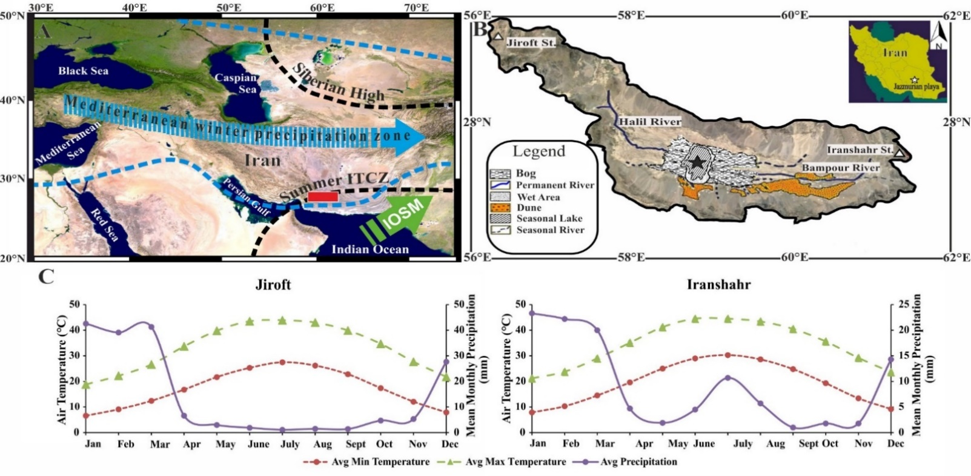
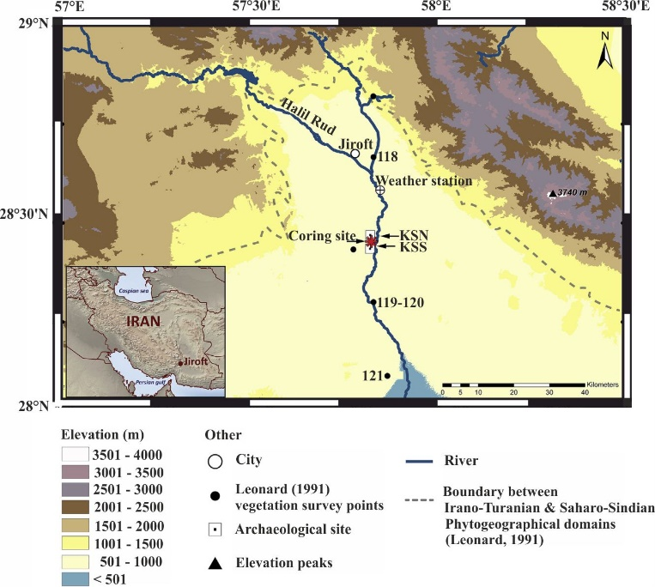
Jazmurian Playa
A dry ephemeral lake. Hot desert like; 100 km south of Jiroft
Seasonal; drained by Halil and Bampour Rivers
Barren xeric landscape; sandstone, conglomerate, marl, breccia, basalts

Slide 14
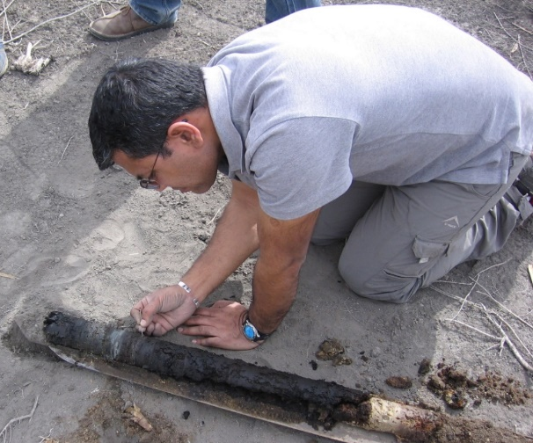
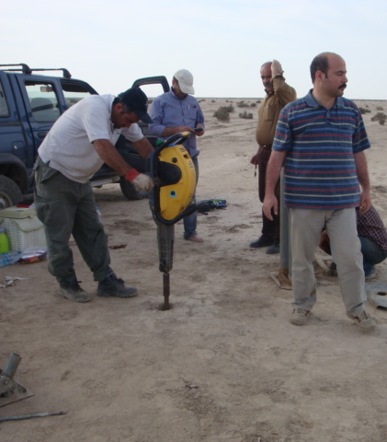
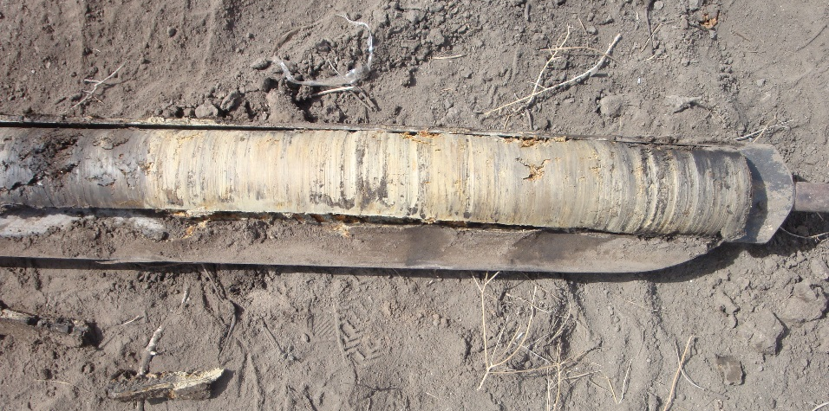
Vibracoring Jazmurian playa (located around 100 km south of Konar Sandal)
Material and methods
Jiroft (Konar Sandal), peat boring

Slide 15
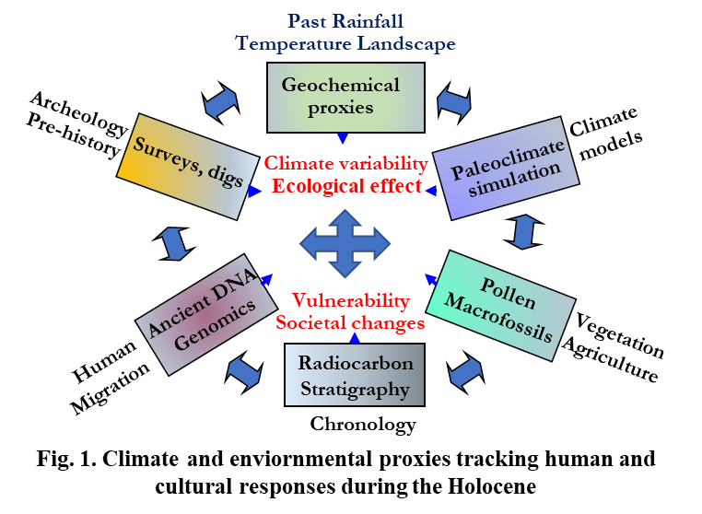
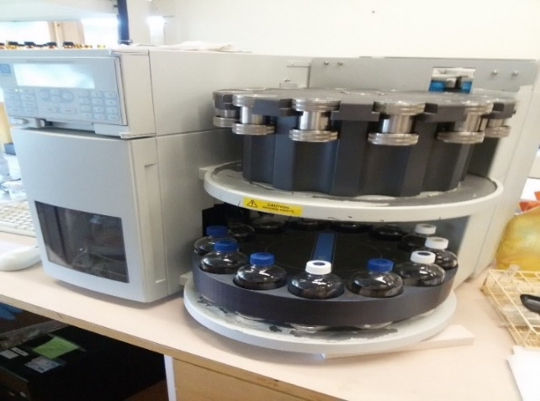
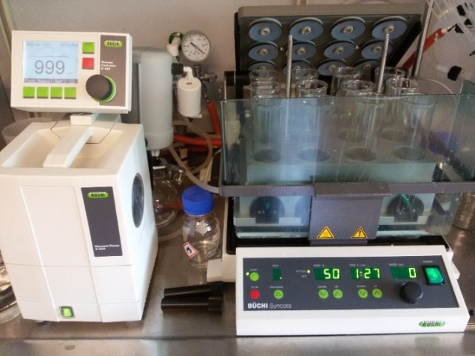
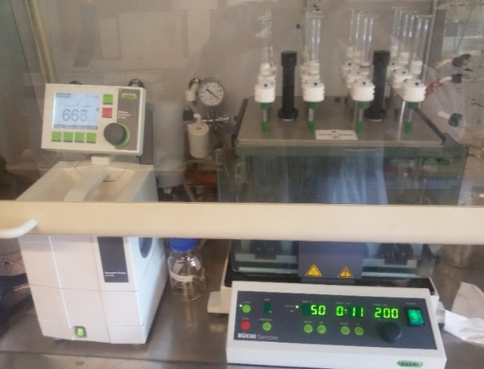
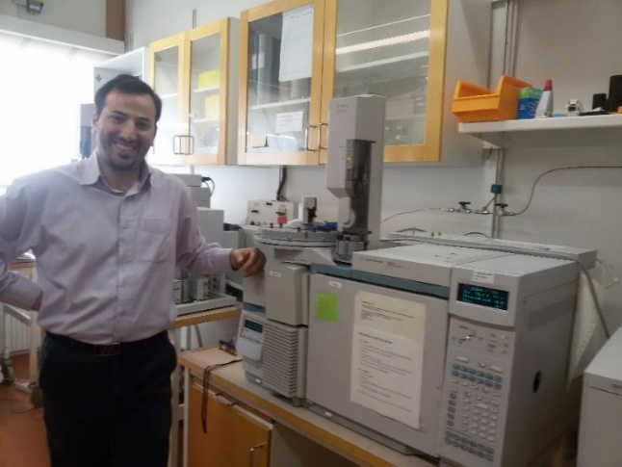
Methods
Multi-proxy data (physical + geochemical)
  Grain-size and magnetic susceptibility (erosion)
  Pollen (vegetation)
  Major and trace metals (erosion, aeolian conditions)
  XRD mineralogy (dry/wet )
  Stable C, N isotopes (sources)
  Biomarkers (organic matter sources, temperature)
  Compound-specific isotope (D, C) analyses (hydrology, source)

Slide 16
Sediment properties Jazmurian playa
The 5-m core extends to c. 21000 cal yr BP
Starts just around LGM and extends to the Holocene covering imp events as YD, BA, 8.2, 4.2 ka

Slide 17
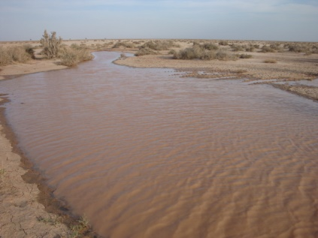
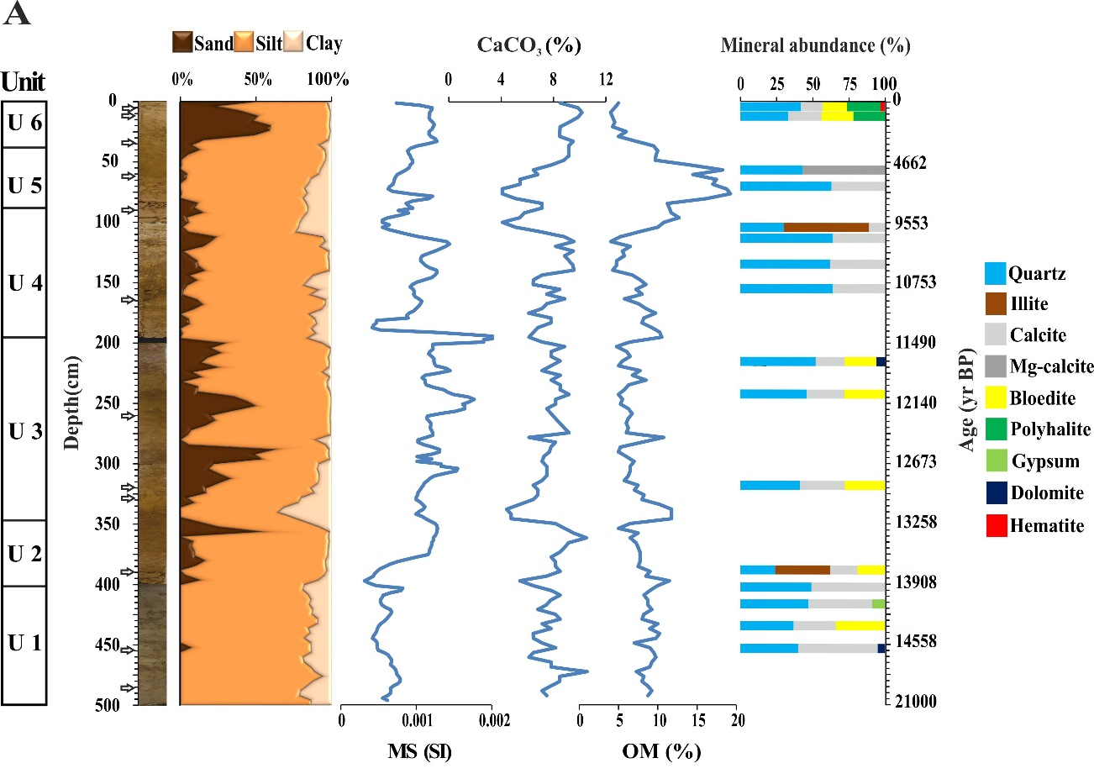
Sediment properties Jazmurian playa

Slide 18
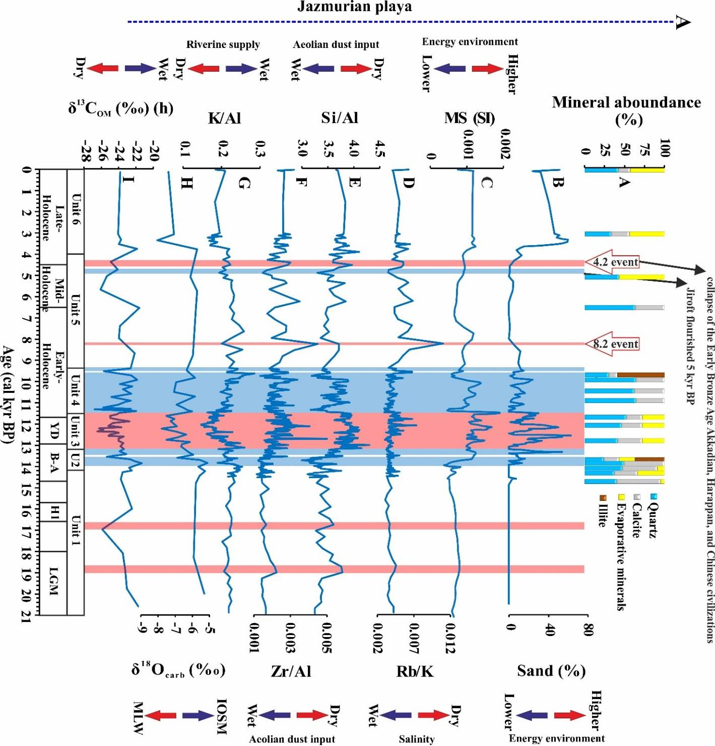
Sediment properties Jazmurian playa
Dry, dessication (Jiroft declines)
Wet, low aeolian input (Jiroft rises)
V wet, increased fluvial inputs low amt of evaporite; IOSM + MLW
Dry, dessication
Increased fluvial inputs low amt of evaporites (14-13.2 ka)
Low MS, fine-grain sediments and aeolian input 21-14 ka

Slide 19
Sediment properties Jazmurian playa

Slide 20
Summary
Strong correlation between Peaks of dust input over the Iranian Plateau with North Atlantic cooling events e.g., Heinrich Stadial 1, the Younger Dryas supports the idea that atmospheric teleconnections most likely existed between these regions (Safaierad et al., 2020; Vaezi et al., 2019).
Our Studiy suggested a greater influence of the IOSM over Iran during Bølling–Allerød period.
The Iranian Plateau was dry and dusty during Younger Dryas.

Slide 21
Summary
Our Studiy suggested a greater influence of the IOSM over Iran during Bølling–Allerød period.
The Iranian Plateau was dry and dusty during Younger Dryas.
Peaks of wet condition during the early Holocene in southeastern Iran was from 11.4 to 9.6 kyr BP.
During early Holocene high solar insolation led to northward displacement of the ITCZ and strengthening and northward expansion of the Indian summer monsoon system.

Slide 22
Summary
Widespread dusty arid condition cover the Iranian plateau during 8.2 kyr BP cold and dry event coincide with the injection of icebergs into the North Atlantic Ocean.
Between 7.8 and 6.3 kyr BP, the southeastern Iran had mild climate and two rainy seasons.
The region receives relatively low rainfall (compare to we early Holocene) of both summer monsoon rainfall and the MLW precipitation in winter season.

Slide 23
Summary
From 6.3 to 5 kyr BP decrease in solar insolation ushered an dusty arid period on the Iranian plateau.
The amount of summer monsoon rains in the southeast of Iran decreased significantly due to decrease in solar insolation which cause change in the origin of southeaster Iran rainfall from IOSM to MLW.
However, the region has also experienced many fluctuations during the late Holocene, which can be attributed to the irregularity of the MLW entering this region.

Slide 24
Summary
Aeolian activity decrease and rainfall increase over the Iranian Plateau abruptly between 5 and 4.5 kyr BP represents wetter condition.
This period is coincide with the flourishing of the Early Bronze Age settlement in the region.
The Plateau experienced dry conditions between 4.5 and 4 kyr BP.
Notably, high aeolian input and dry condition around 4.2 kyr BP suggests more arid conditions in all of the Middle East and Western Asia and can be associated with the decline of Early Bronze Age settlement.

Slide 25
Some published papers

Slide 26
Acknowledgements
Iran: RIES, University of Tehran, INIOAS
Sweden: LiU
Germany: Max Planck Inst-Jena, Potsdam University
France: Univ Aix-Marsielles, Natural History Museum-Paris
USA: University of Florida, Notre Dame Univ
Funding - Swedish Research Council

Slide 27


