Slide 1
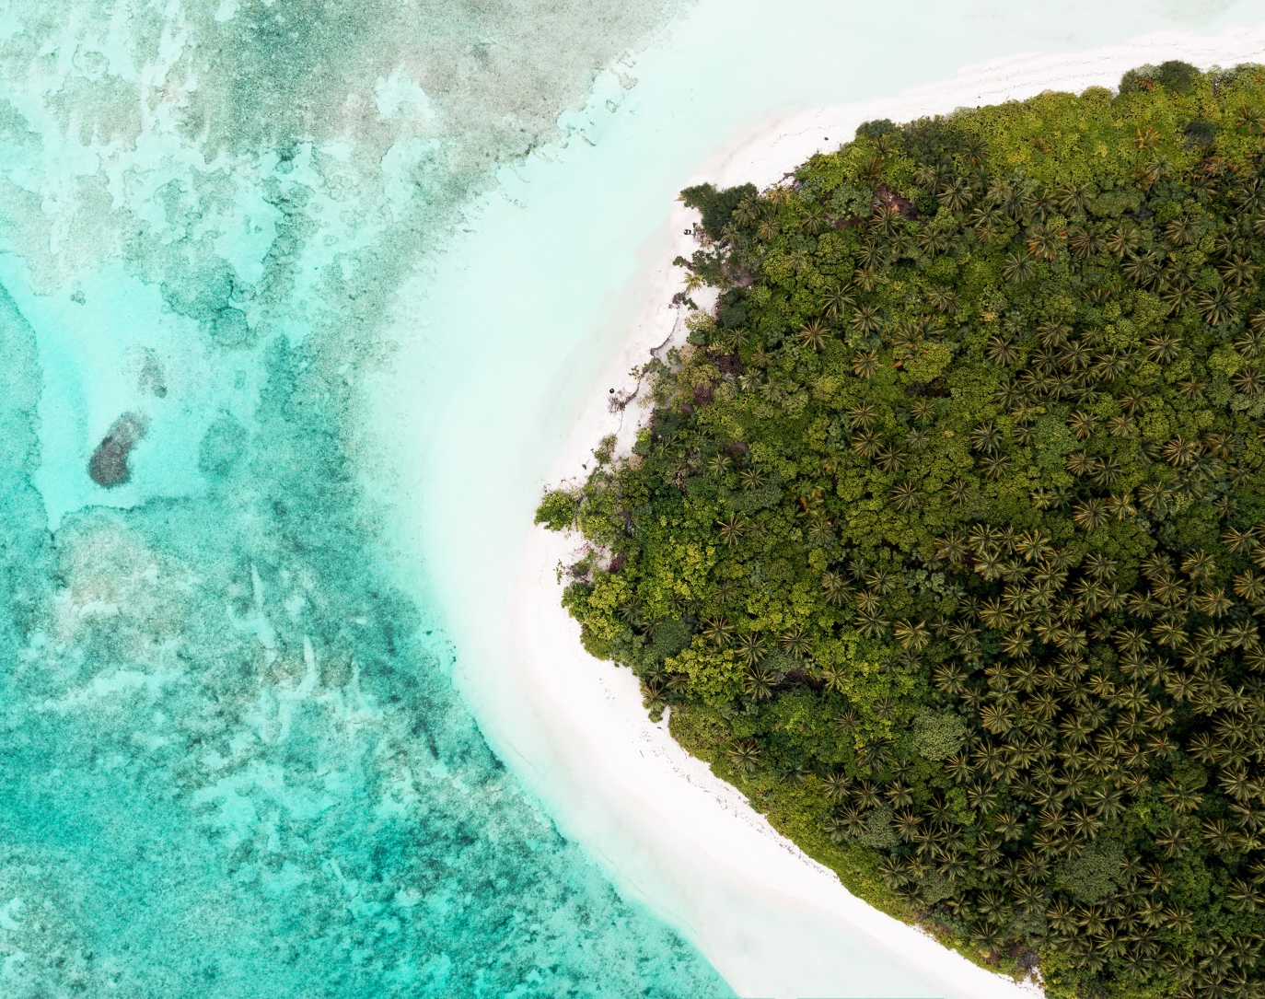
The Third Phase of Workshop Series on
The Effects of Climate Change on the Indian Ocean Marine Environment
Maldives Country Report
Ms. Afa Husain
Ministry of Environment, Climate Change & Technology
February 2023
Photo Credits: Ahmed Anwar

Slide 2
Overview
Situated in the Indian Ocean
Archipelago of islands, 1192 low-lying islands, clustered into 26 atolls
Resident Population; 568,362 (NBS 2020)
Average elevation of islands are 1.5 metres above sea-level (MEE 2016)
These physical features make Maldives highly vulnerable to environmental change and natural hazards.
These islands are also extremely vulnerable economically.
Covid-19 further exposed the underlying vulnerabilities of the tourism-led economic model of the country

Slide 3
Vulnerability Profile
Change in rainfall patterns
Flooding
Food security
Saltwater intrusion
Loss of vegetation
Loss of wetlands & waterbodies
Groundwater pollution
Infrastructure damage
Degraded water quality
Waterborne diseases

Slide 4
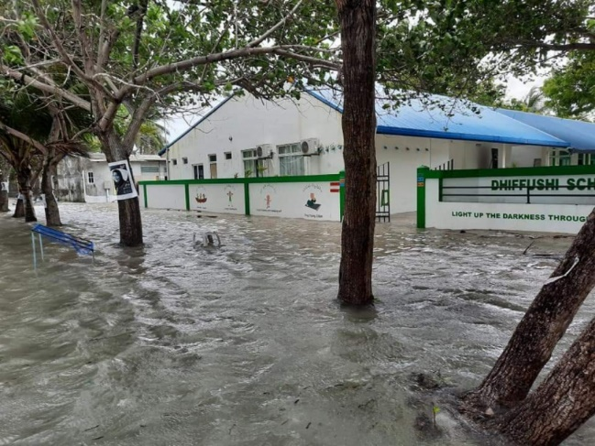
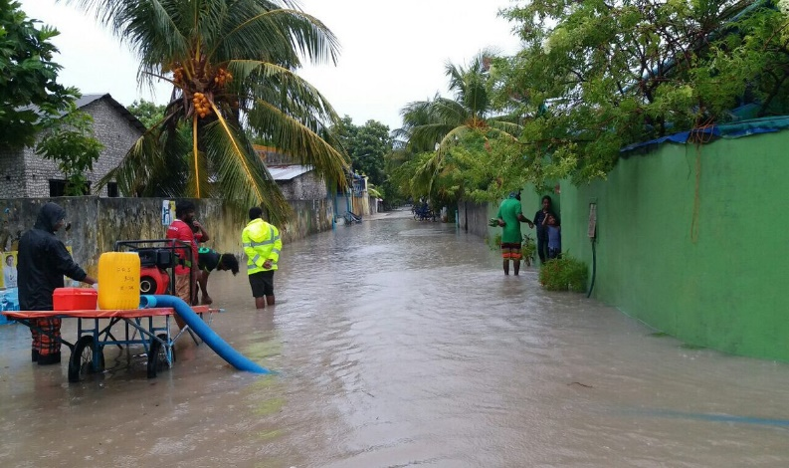
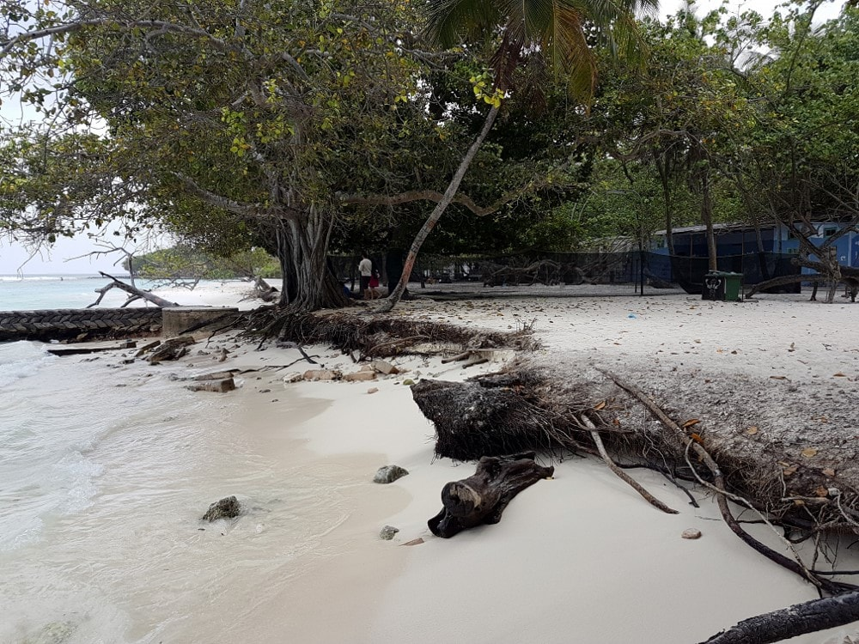
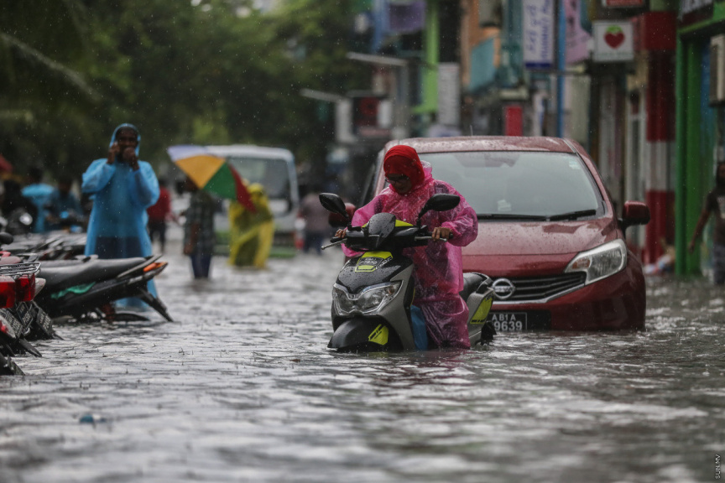
Severe impacts of Climate Change
Coastal-inundation due to sea-level rise is a major threat to our islands
Significantly threatens critical infrastructure (schools, hospitals, utilities etc) situated near the shorelines
Nearly 50% of all housing structures are also within 100 meters from the coastline, while only few of this are capable of withstanding tidal floods, let alone tsunamis
90% of the islands have reported flooding annually
97% are reporting shoreline erosion
64% of the islands are experiencing severe erosion
Credits: Sun.mv
Credits: Maldives Independent
Credits: Sun.mv
Credits: Maldives finest
More than 44% of human settlement and more than 80% of critical infrastructure in Maldives is within 100m of coast, SOE 2016

Slide 5
Climate Emergency Act (No: 9/2021)
Ratified by President in May 2021
Stipulates actions to address the climate emergency resulting from the severe impacts of climate change
Introduces;
Legal Structure and guidelines for addressing issues and concerns related to climate change
Enhance adaptation and resilience
Formulation of special fund for Climate actions and investments
Development of an action plan to address climate change
Carbon budgeting to meet net zero emissions by 2030

Slide 6
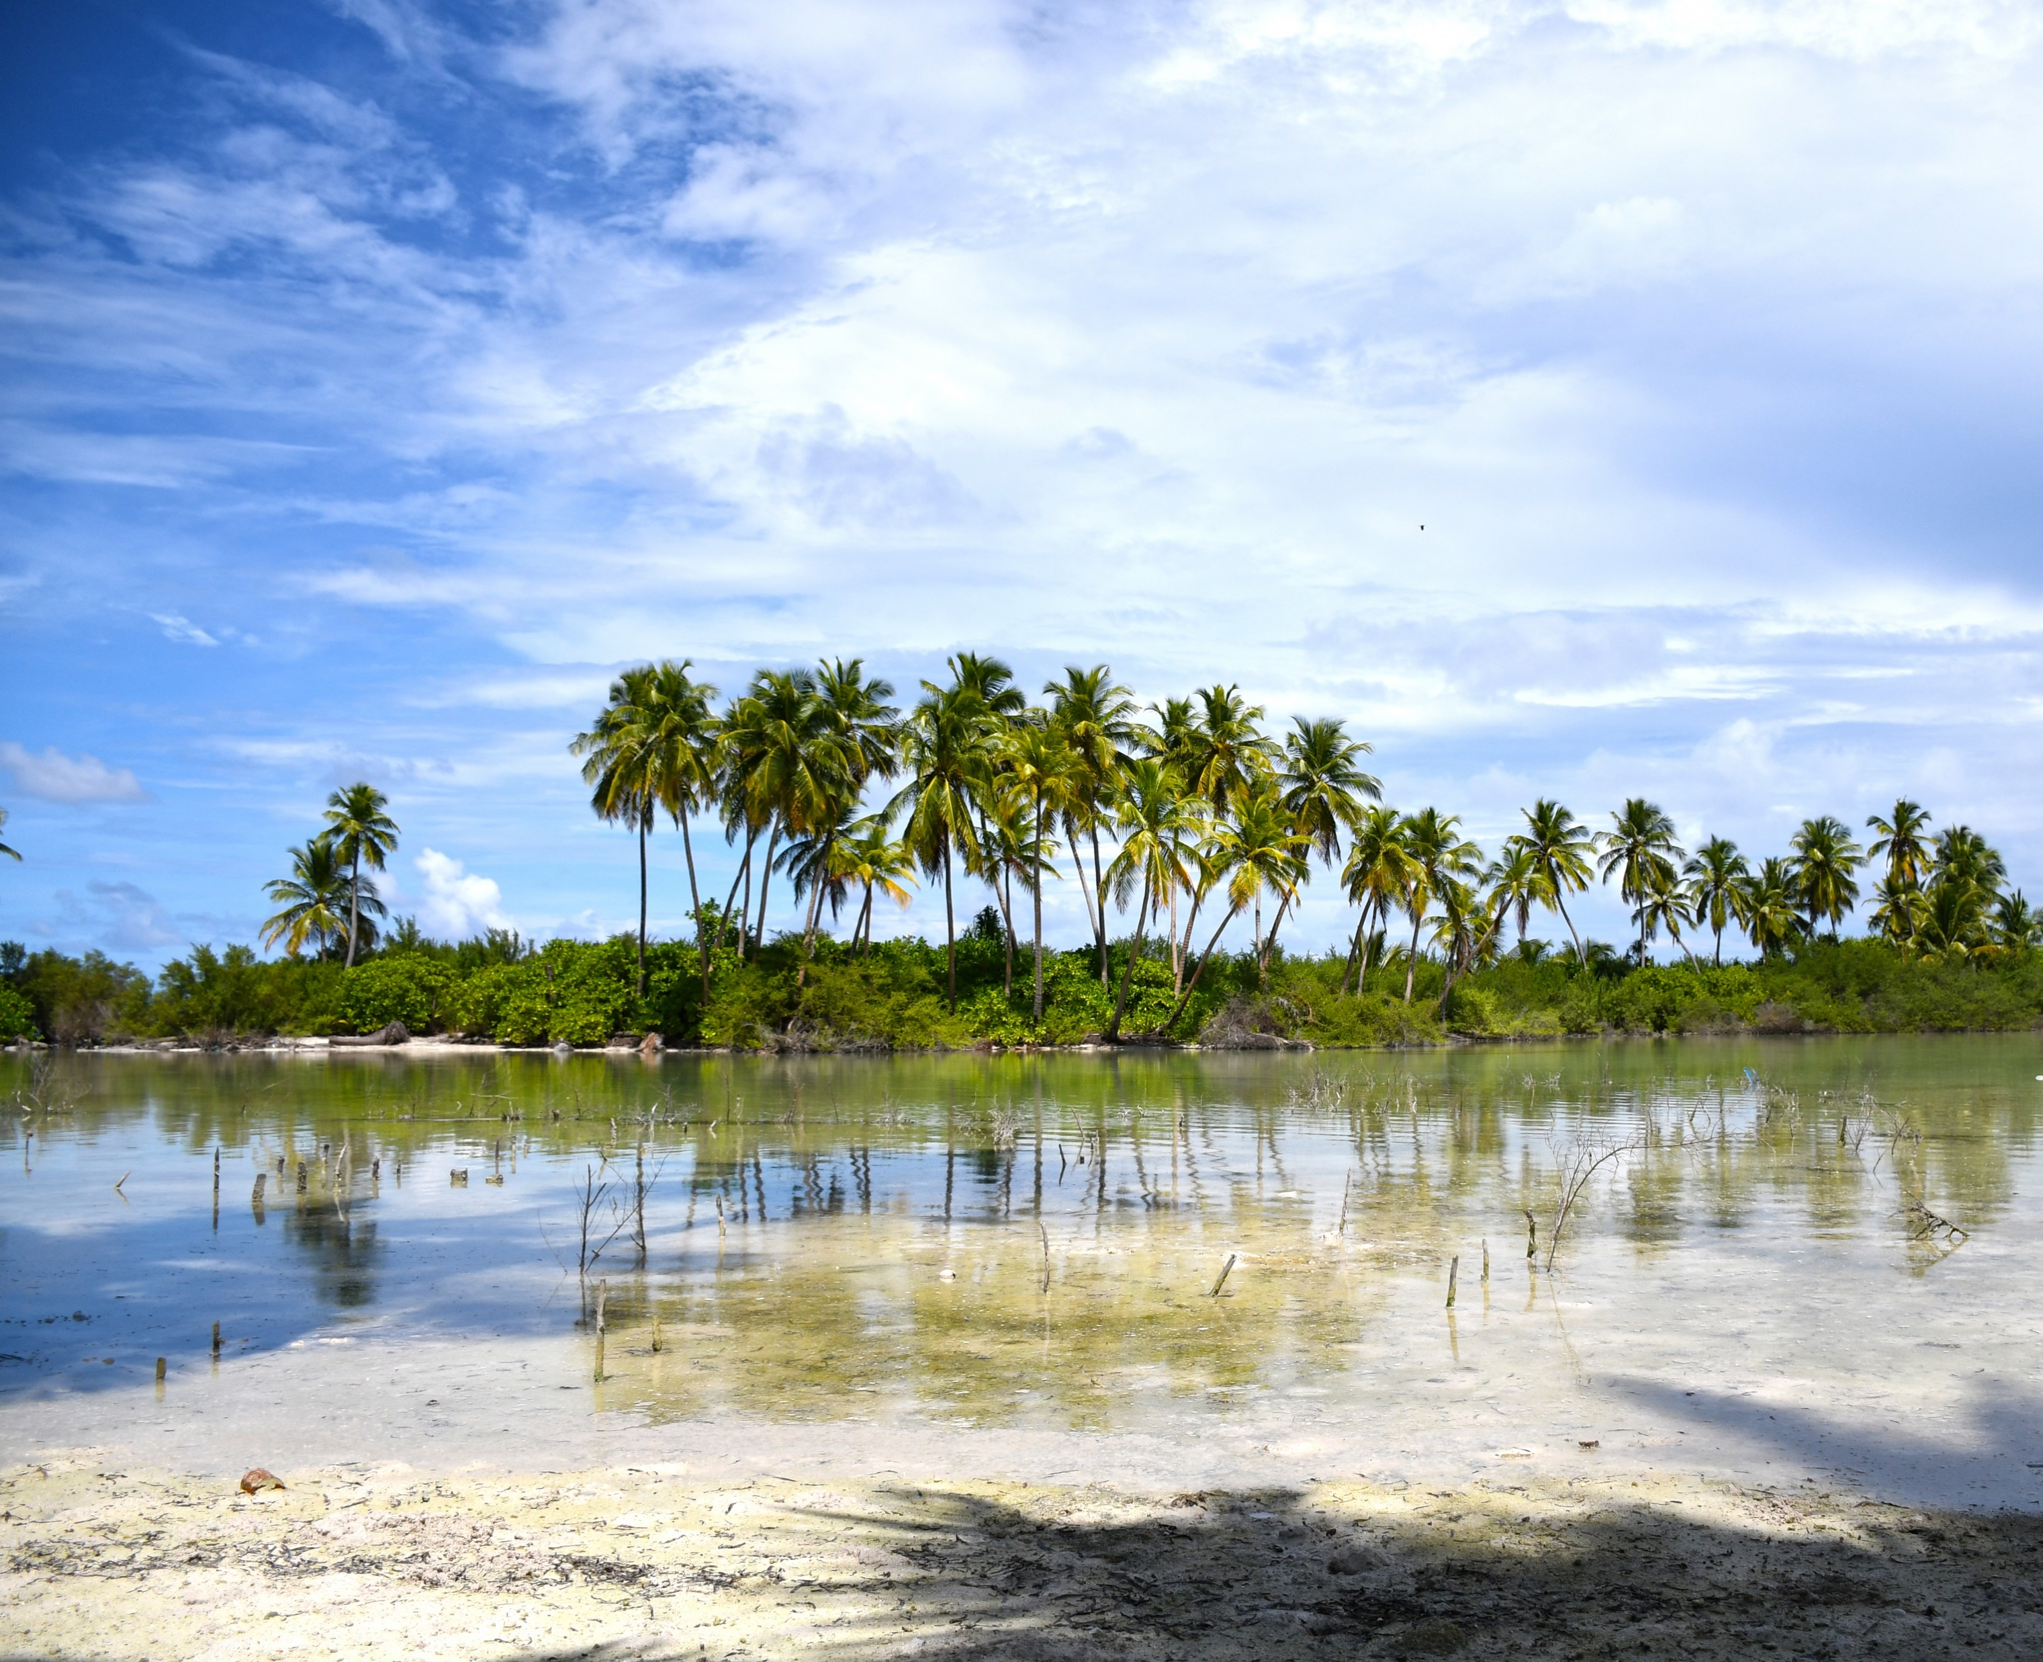
Climate Change Policy Initiatives
Credits: Ahmed Anwar

Slide 7
Climate Emergency Act (No: 9/2021)
Ratified by President in May 2021
Stipulates actions to address the climate emergency resulting from the severe impacts of climate change
Introduces;
Legal Structure and guidelines for addressing issues and concerns related to climate change
Enhance adaptation and resilience
Formulation of special fund for Climate actions and investments
Development of an action plan to address climate change
Carbon budgeting to meet net zero emissions by 2030

Slide 8
Strategies on Adaptation actions
Vulnerabilities | Adaptation Actions
Enhancing Agriculture & Food Security | Climate risk insurance for farmers Enhance food production Better food supply storage and transportation
Protection of critical infrastructure | Coastal protection Climate proofing of critical infrastructure such as powerhouses, health facilities, airports etc Integration of climate change into planning process such as building code and Land use planning Flood mitigation initiates Policy interventions such as National Development Act, Spatial Planning
Public Health | Vector Surveillance programmes
Fisheries | Diversification of Fisheries Mari-culture Value added products

Slide 9
Vulnerabilities | Adaptation Actions
Water Security | Proper sanitation via sewerage systems Desalination Integrated Water Resource Management Water security
Coral reefs | Protecting coral reefs Better oceanographic data Reduce land based pollution via proper sanitation
Tourism | Investing on climate risk management initiatives Climate risk insurance

Slide 10
Maldives Updated Nationally Determined Contribution
26% reduction of emissions in 2030 (under BAU), in the context of sustainable development, supported and enabled by availability of financial resources, technology transfer and capacity building
GoM believes that it has a responsibility to take a more transformational economic and environmental plan to development, hence aims to reach net zero emissions by 2030, if adequate donor assistances are received
NDC also plays an equal importance on enhancing adaptation and resilience building measures

Slide 11
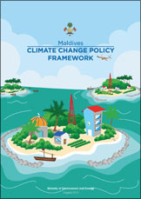
Climate Change Policy Framework (2015)
‘to recognize the status of Maldives as a nation suffering from the adverse impacts of climate change and to build its capacity to ensure a safe, sustainable, resilient and prosperous future’
Provides a comprehensive framework for national action and international engagement
Prescribes the Government’s strategic polices for responding to climate change impacts over the next 10 years (2015–2025)
Consists of 5 thematic areas

Slide 12
Climate Change Measures
Credits: Ahmed Anwar

Slide 13
On-going Climate Adaptation Measures
GCF Project – supports vulnerable communities in Maldives to climate change induced water shortages
GCF Project – Building Climate Resilient Safer Islands in the Maldives (Coastal Protection)
Biodiversity Protection; We have 79 environmentally significant areas, which is estimated as 13 percent of coral reef area of Maldives. Works are underway to protect more areas as well. We also have 3 entire atolls designated as UNESCO Biosphere Reserves.
Blue Economy Programme; research and planning to ensure that development does not hinder the beauty of our marine resources
Many other PSIP and donor funded adaptation measures on-going across various sectors

Slide 14
Maldives Red List Assessments
With the Maldives Red List Initiative, the first taxa we evaluated was Marine Reptiles, followed by the Coral assessments that were published in October 2022, more assessments of other species planned for 2023

Slide 15
Other Effective Conservation Measures (OECMs)
Guidelines established on recognizing Other Effective Area Based Conservation Measures (OECMs) in the areas leased for tourism operations in the Maldives and start the work to ensure that the resorts are sustainably managed areas. This gives the opportunity for the private sector to be part of our conservation program through internationally recognized designations. OECMs is recognized under the convention on biological Diversity

Slide 16
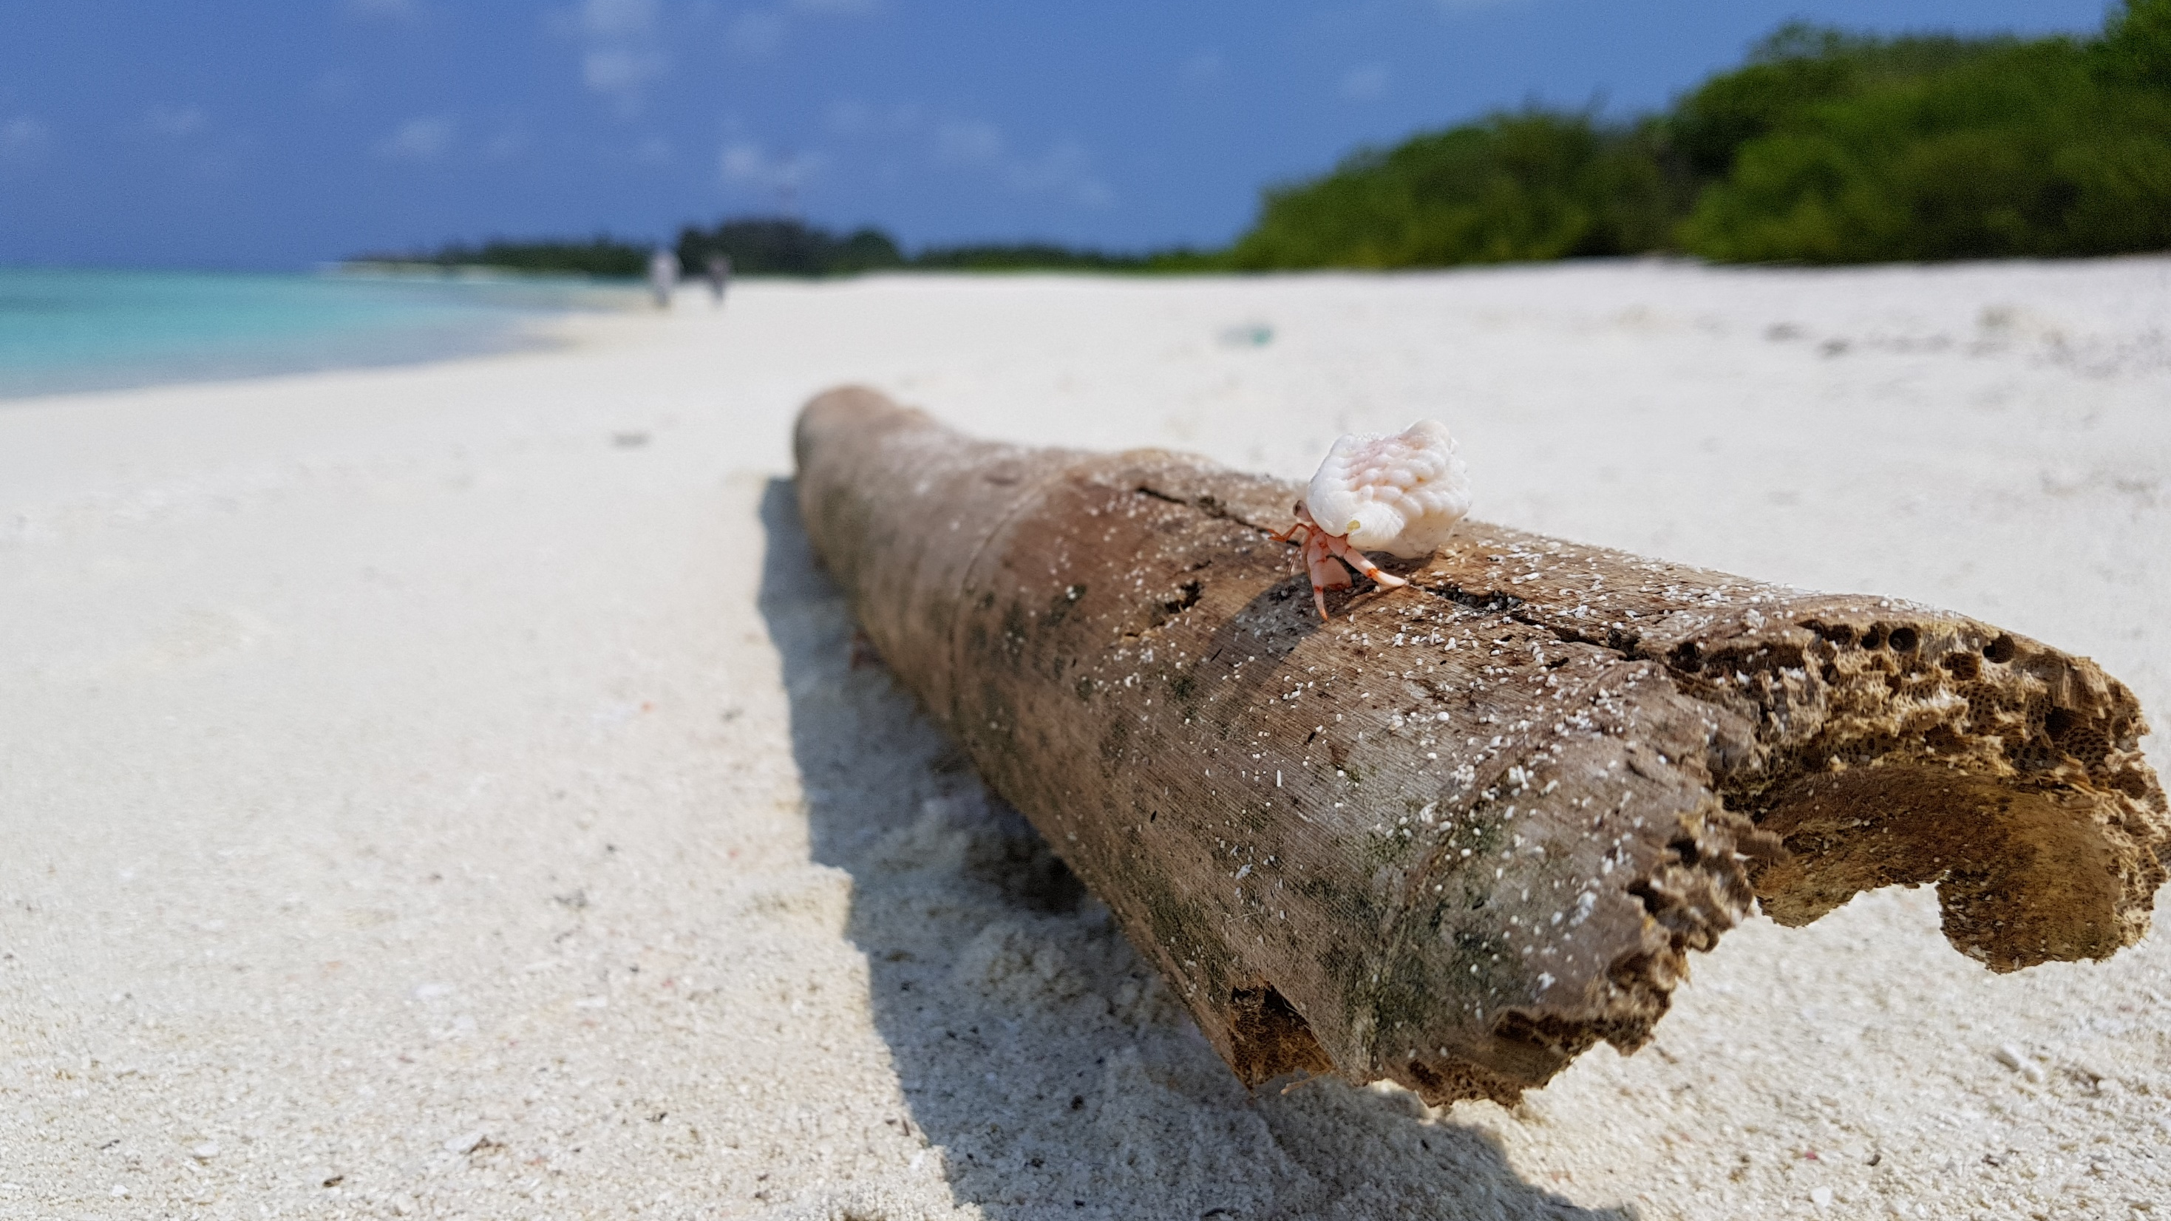
Thank you!
Credits: Ali Shareef

