Slide 1
Relationship between climatic indices and TC characteristics over the Indian Ocean Dr. Nafiseh Pegahfar, INIOAS, Iran

Slide 2
From https://www.wikiwand.com/en/North_Indian_Ocean_tropical_cyclone#Media/File:Luban_and_Titli_2018-10-10_0745Z%E2%80%930926Z.jpg

Slide 3
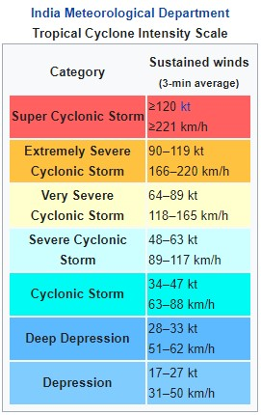
From

Slide 4
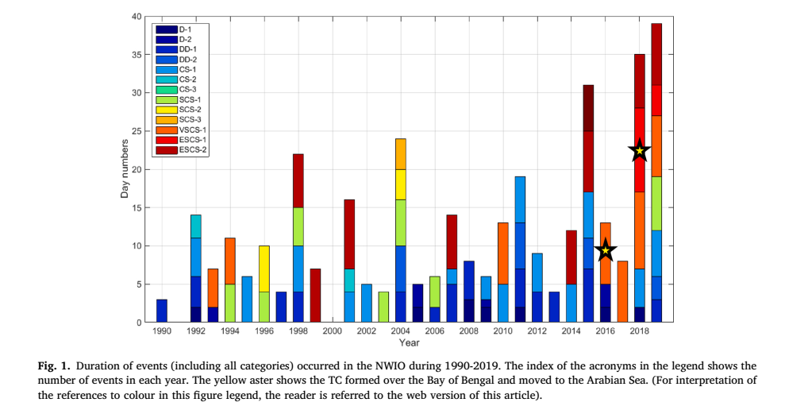

Slide 5
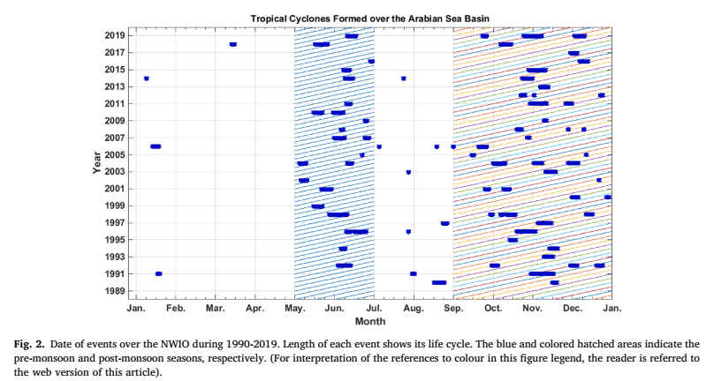

Slide 6
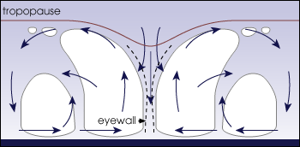
Figure 2-1: from https://www.cs.mcgill.ca/~rwest/wikispeedia/wpcd/images/136/13677.gif

Slide 7
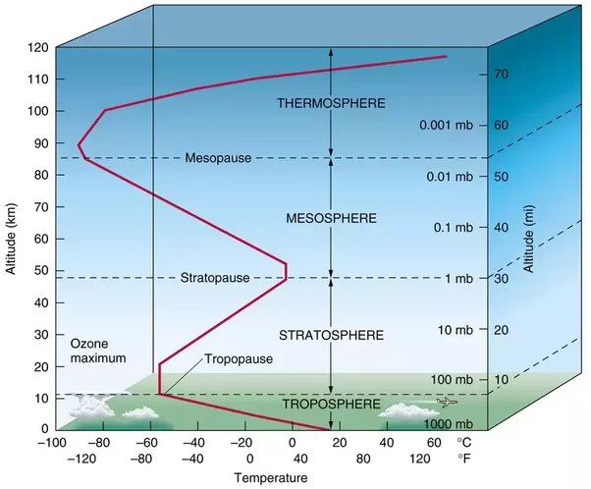
Figure 2-2: https://qph.cf2.quoracdn.net/main-qimg-0d3ab62751f4b8ae5028496e501e657e-pjlq

Slide 8
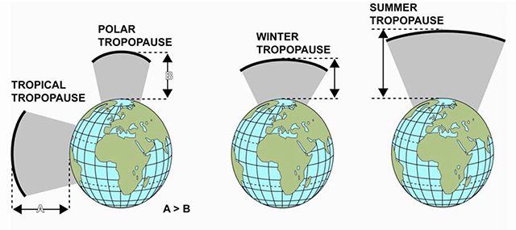
Figure 2-3: https://code7700.com/tropopause.htm

Slide 9
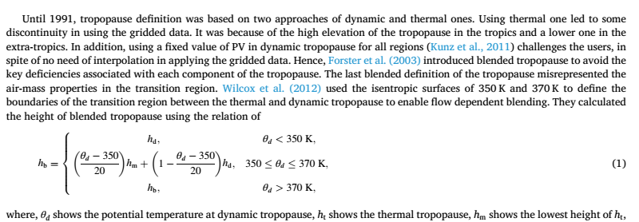

Slide 10
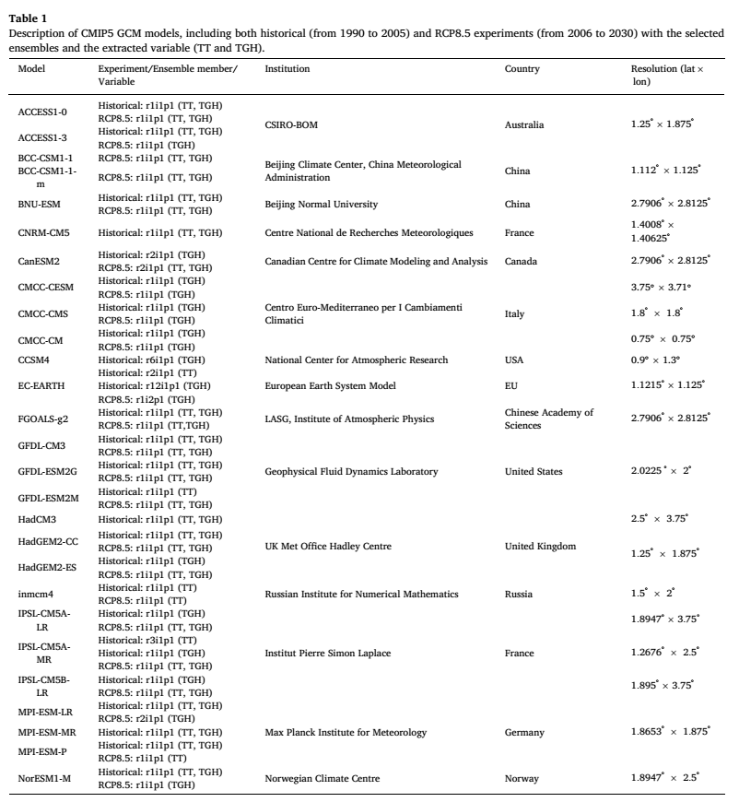

Slide 12
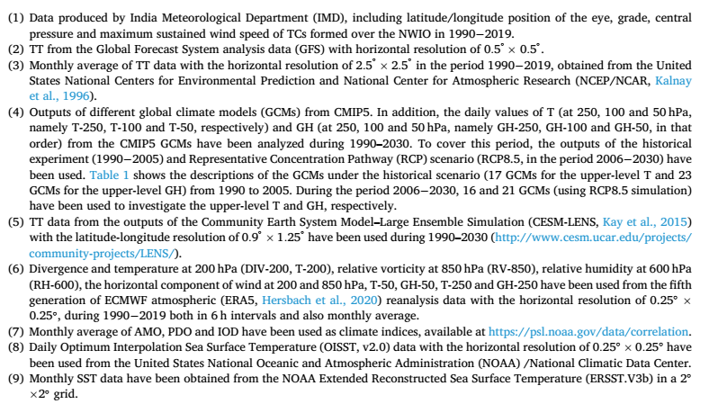

Slide 13
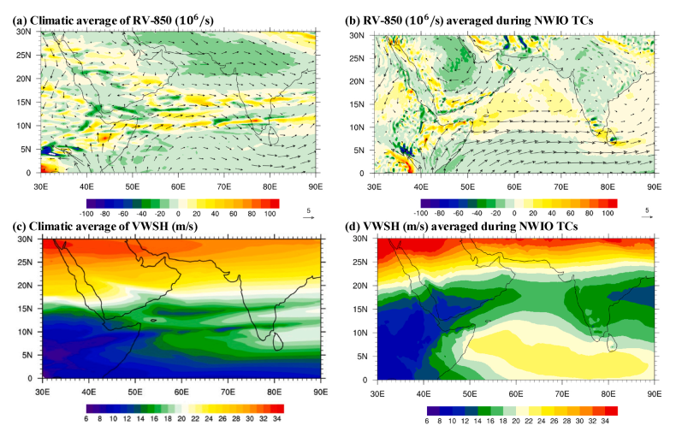

Slide 15
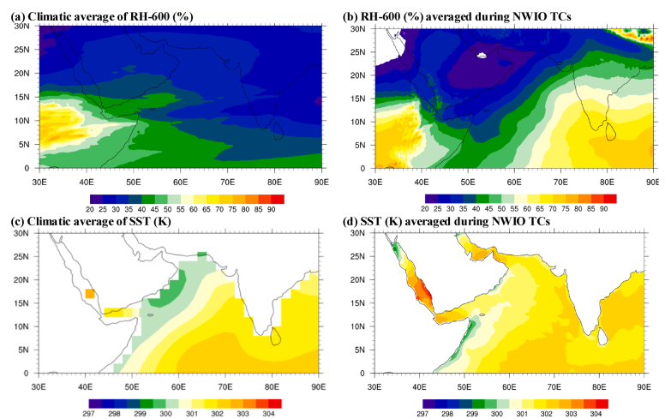

Slide 17
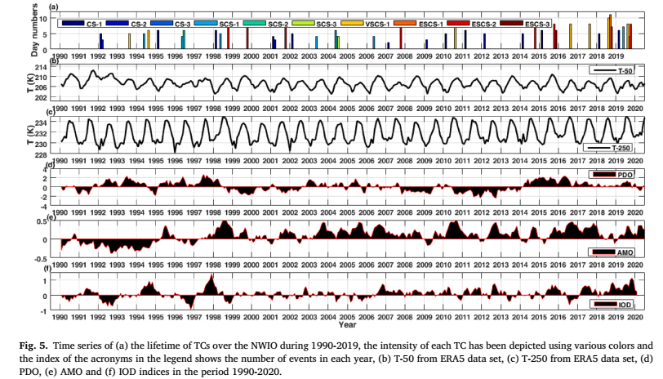

Slide 18
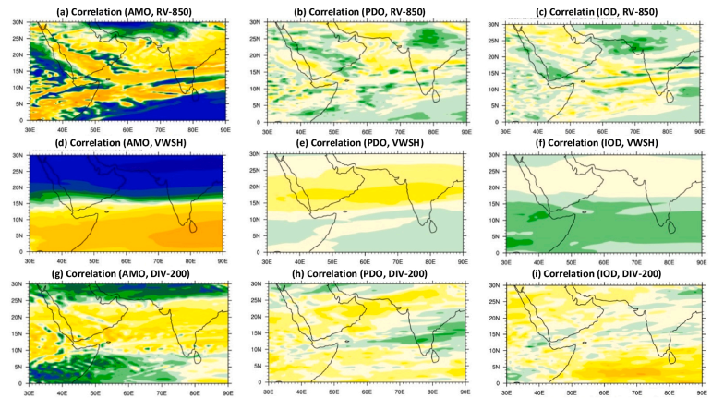

Slide 19
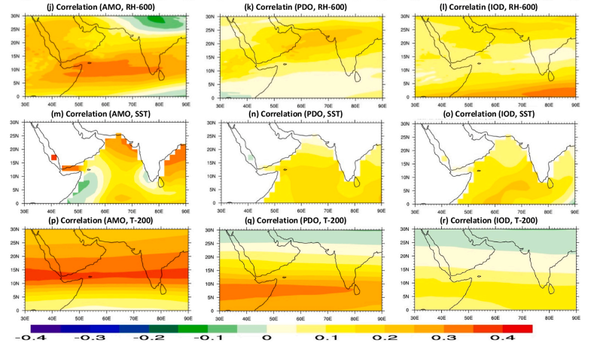

Slide 20
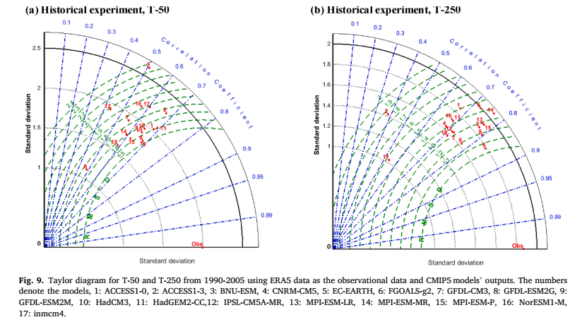

Slide 21
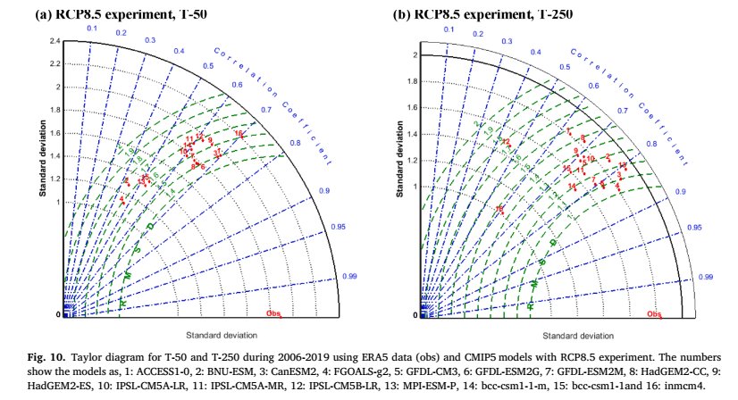

Slide 22
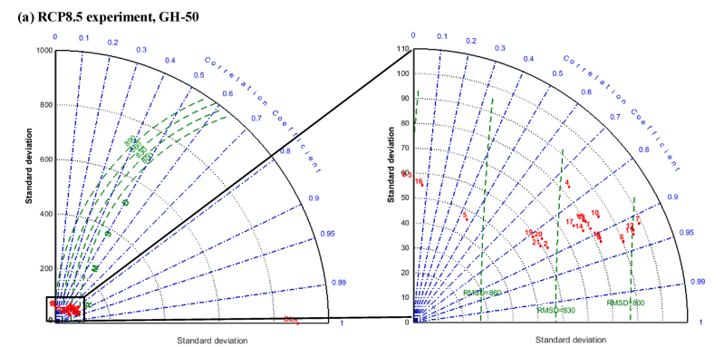

Slide 23
