Slide 1
IN The Name of GOD
Climate Change, Oceans and Cryosphere
Dr. Sahar Tajbakhsh
Deputy Minister of Road and Urban Development
and
Permanent Representative of I.R. of Iran Meteorological Organization with WMO
dr.tajbakhsh@irimo.ir

Slide 2
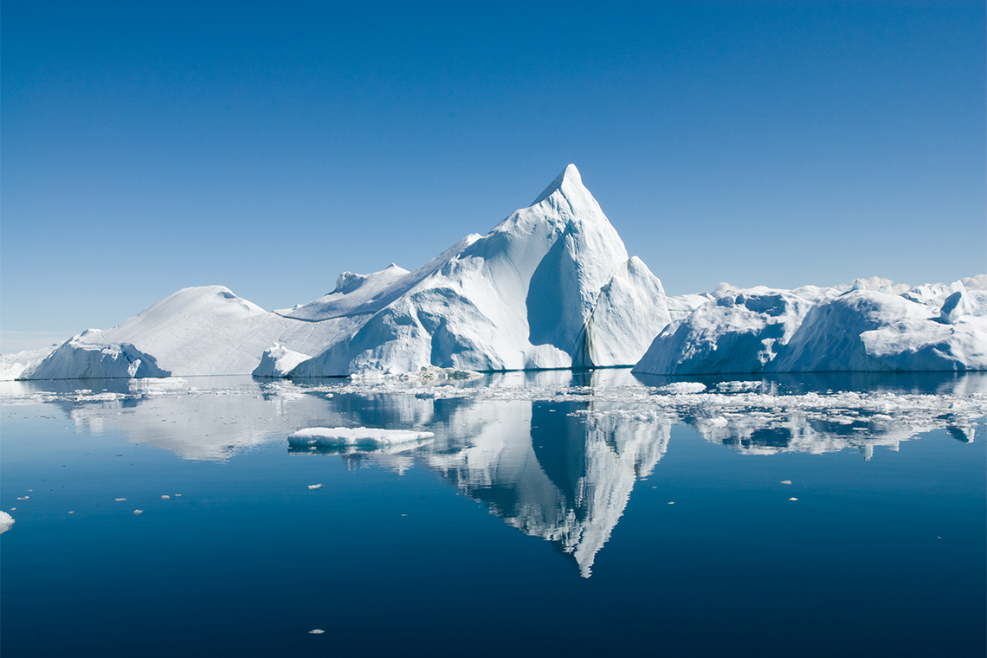
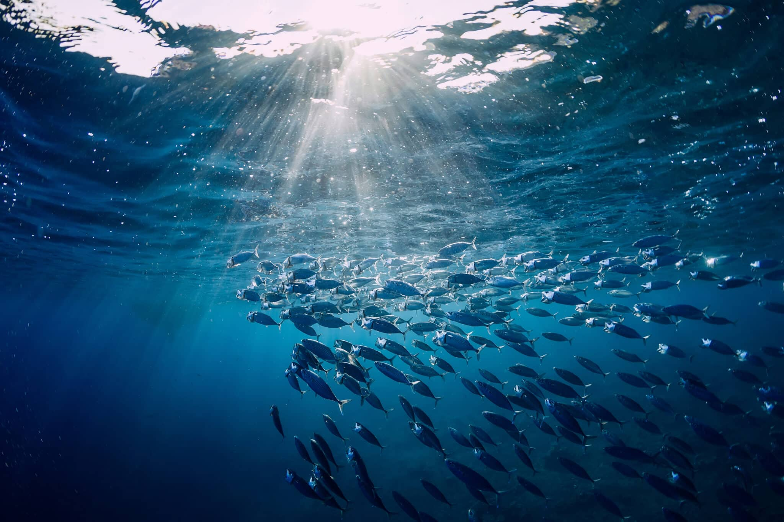
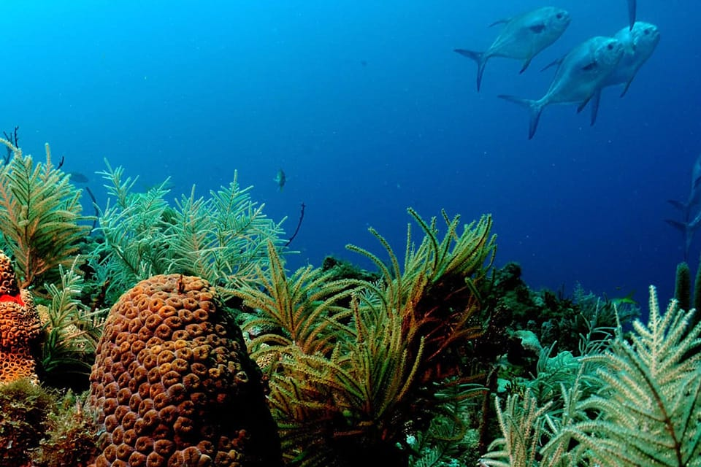
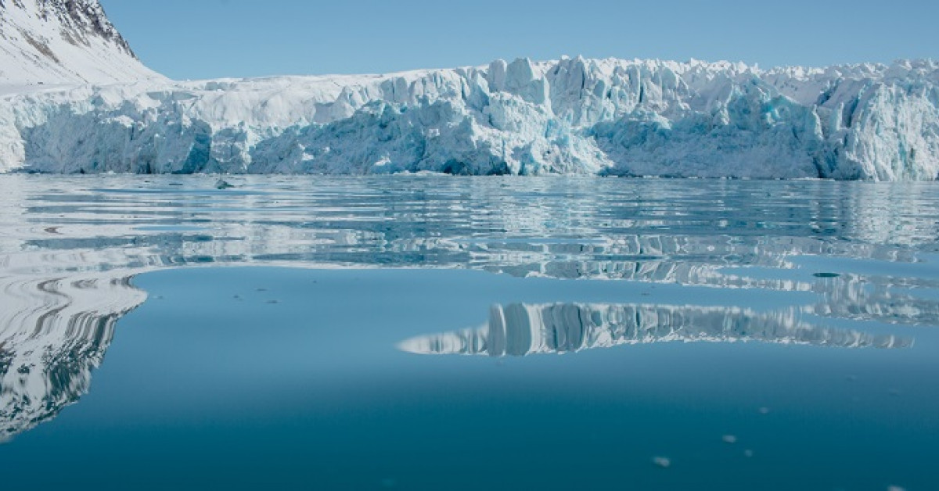
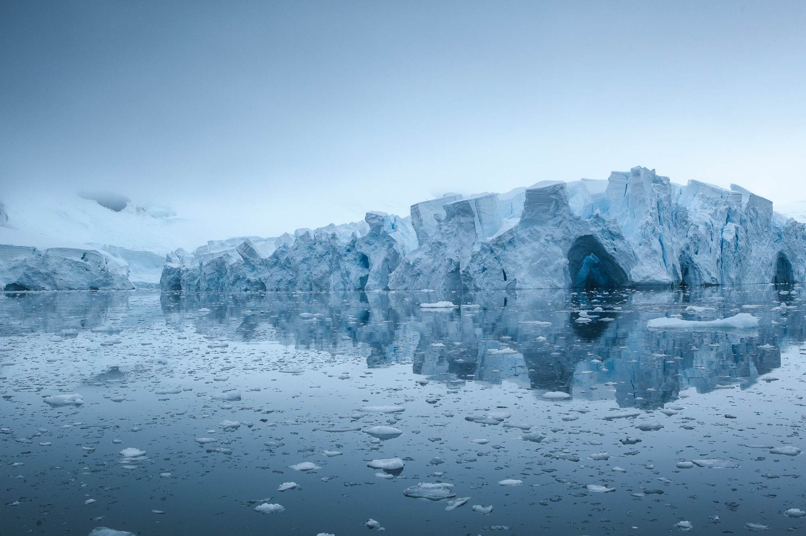
The importance of Oceans and Cryosphere for People
Notes:
All people on Earth depend directly or indirectly on the ocean and cryosphere. The global ocean covers 71% of the Earth surface and contains about 97% of the Earth’s water. The cryosphere refers to frozen components of the Earth system. Around 10% of Earth’s land area is covered by glaciers or ice sheets.
Human communities in close connection with coastal environments, small islands, polar areas and high mountains are particularly exposed to ocean and cryosphere change, such as sea level rise, extreme sea level and shrinking cryosphere. Today, around 4 million people live permanently in the Arctic region. The low-lying coastal zone is currently home to around 680 million people and around 670 million people, live in high mountain regions in all continents except Antarctica.

Slide 3
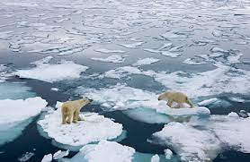
Climate Change and Its Impacts
Notes:
Increasing emissions of greenhouse gases into the atmosphere from the burning of fossil fuels are causing changes in the ocean . These changes can alter which species of marine life thrive best in certain areas. For example, many fish have shifted their typical range as water temperatures rise. However, other species are expected to decline in number or leave areas that are no longer favorable for them. These shifts can have significant impacts on marine ecosystems and on fishing communities.
Many climate change impacts will only be avoided by reducing carbon dioxide emissions. Many organizations are working together to protect coral reefs, which face hazards such as bleaching, infectious diseases, smothering from sediment, collapses in fish stocks, and other issues. Such strategies can help preserve and protect marine resources. Even with these efforts, however, it will take decades or longer for the ocean to recover.

Slide 4
The current state of climate
Human influence has warmed the climate at a rate that is unprecedented in at least the last 2000 years.
History of global temperature change and causes of recent warming
Notes:
In this slide you can see the current state of climate. In Panel a) changes in global surface temperature reconstructed from paleoclimate archives (solid grey line) and from direct observations (solid black line), both relative to 1850–1900 and decadally averaged. The grey shading with white diagonal lines shows the very likely ranges for the temperature reconstructions.
In panel b) Changes in global surface temperature over the past 170 years (black line) relative to 1850–1900 and annually averaged, compared to climate model simulations of the temperature response to both human and natural drivers (brown), and to only natural drivers (solar and volcanic activity, green). Solid coloured lines show the multi-model average, and colored shades show the very likely range of simulations.

Slide 5
Observed regional impacts from changes in the ocean and the cryosphere
Notes:
Synthesis of observed regional hazards and impacts in ocean (top) and high mountain and polar land regions (bottom) assessed in SROCC. For each region, physical changes, impacts on key ecosystems, and impacts on human systems and ecosystem function and services are shown. For physical changes, yellow/green refers to an increase/decrease, respectively, in amount or frequency of the measured variable. For impacts on ecosystems, human systems and ecosystems services blue or red depicts whether an observed impact is positive (beneficial) or negative (adverse), respectively, to the given system or service. Cells assigned ‘increase and decrease’ indicate that within that region, both increase and decrease of physical changes are found, but are not necessarily equal; the same holds for cells showing ‘positive and negative’ attributable impacts. ((ادامه توضیح روی شکل
For high mountain and polar land regions, the level of confidence in attributing physical changes and impacts at least partly to a change in the cryosphere is shown. No assessment means: not applicable, not assessed at regional scale, or the evidence is insufficient for assessment. (ادامه توضیح روی شکل)

Slide 6
The Past and Future changes in the Oceans
Human activities affect all the major climate system components, with some responding over decades and others over centuries.
Notes:
In Panel a) Global surface temperature changes can be seen in °C relative to 1850–1900. These changes were obtained by combining the model simulations with observational constraints based on past simulated warming, as well as an updated assessment of equilibrium climate sensitivity. Panel b) it can be seen September Arctic sea ice area in 106 km2 based on the model simulations. Very likely ranges are shown for SSP1-2.6 and SSP3-7.0. In Panel c), the Global ocean surface pH (a measure of acidity) is simulated based on CMIP6 model. Very likely ranges are shown for SSP1-2.6 and SSP3-7.0. Global mean sea level change in meters relative to 1900 is shown in panel d). The dashed curve indicates the potential impact of these deeply uncertain processes. And Panel e) shows us Global mean sea level change at 2300 in meters relative to 1900.

Slide 7
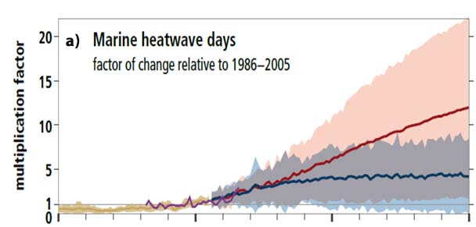
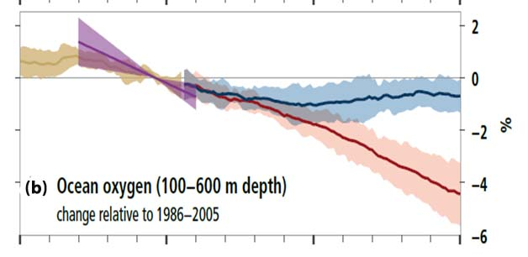
The Past and Future changes in the Oceans
Notes:
Globally, marine heat-related events have increased; marine heatwaves, defined when the daily sea surface temperature exceeds the local 99th percentile over the period 1982 to 2016, have doubled in frequency and have become longer-lasting, more intense and more extensive (very likely). It is very likely that between 84–90% of marine heatwaves that occurred between 2006 and 2015 are attributable to the anthropogenic temperature increase.
By 2081–2100 under RCP8.5, ocean oxygen content (medium confidence), are projected to decline globally by very likely ranges of 3–4%, relative to 2006–2015 and under RCP2.6 are smaller compared to RCP8.5 for oxygen loss (very likely).

Slide 8
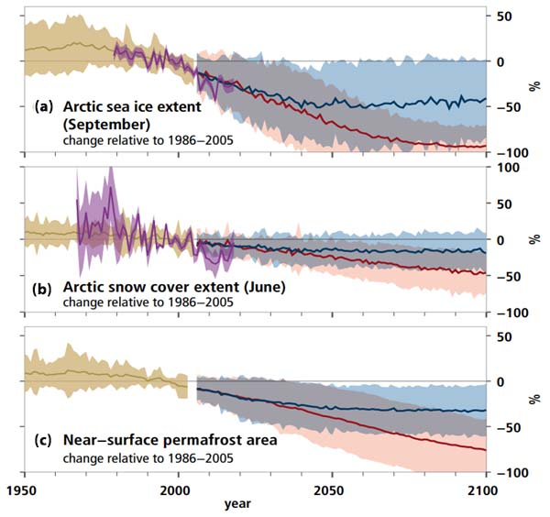
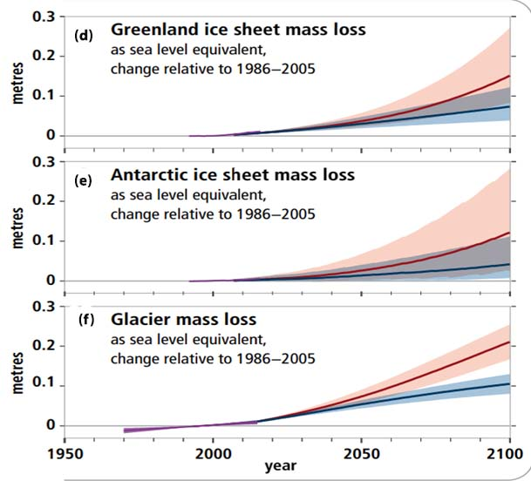
The Past and Future Changes in The Cryosphere
Observed and modelled historical changes in the ocean and cryosphere since 195011, and projected future changes under low (RCP2.6) and high (RCP8.5) greenhouse gas emissions scenarios
Notes:
Between 1979 and 2018, Arctic sea ice extent has very likely decreased for all months of the year. September sea ice reductions are very likely 12.8 ± 2.3% per decade.
Arctic June snow cover extent on land declined by 13.4 ± 5.4% per decade from 1967 to 2018, a total loss of approximately 2.5 million km2, predominantly due to surface air temperature increase (high confidence).
Permafrost temperatures have increased to record high levels (1980s–present)including the recent increase by 0.29ºC ± 0.12ºC from 2007 to 2016 averaged across polar and high mountain regions globally.
Ice sheets and glaciers worldwide have lost mass. Between 2006 and 2015, the Greenland Ice Sheet lost ice mass at an average rate of 278 ± 11 Gt yr–1, mostly due to surface melting (high confidence). In 2006–2015, the Antarctic Ice Sheet lost mass at an average rate of 155 ± 19 Gt yr–1, mostly due to rapid thinning and retreat of major outlet glaciers draining the West Antarctic Ice Sheet (very high confidence). Glaciers worldwide outside Greenland and Antarctica lost mass at an average rate of 220 ± 30 Gt yr–1 (equivalent to 0.61 mm yr–1 sea level rise) in 2006–2015.

Slide 9
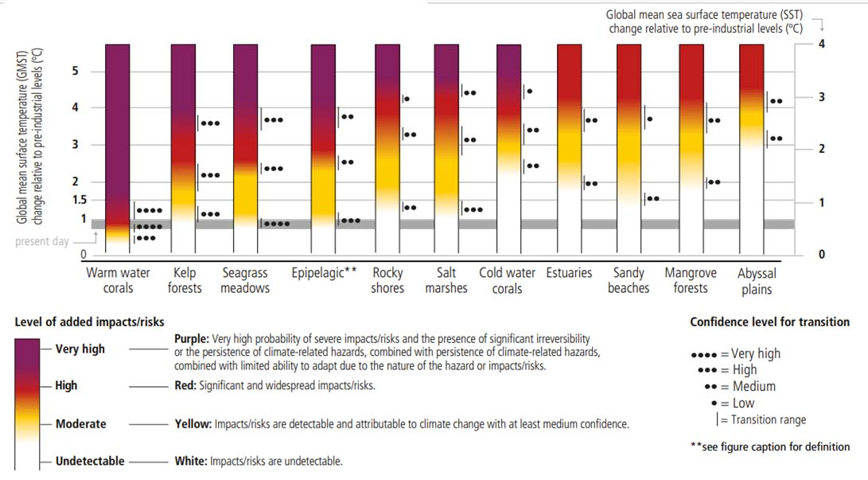
The Impact and Risk to Ocean Ecosystem from Climate Change
Notes:
Assessment of risks for coastal and open ocean ecosystems based on observed and projected climate impacts on ecosystem structure, functioning and biodiversity can be seen in this diagram. The figure indicates assessed risks at approximate warming levels and increasing climate-related hazards in the ocean. (ادامه روی شکل توضیح)

Slide 10
Multiple climatic impact-drivers are projected to change in all regions of the world

Slide 11
There is a 90% chance that at least one year between 2021-2025 will be the hottest year on record.
A terrible prospect could be ahead of the planet

Slide 12
References
Working Group I contribution to the Sixth Assessment Report of the Intergovernmental Panel on Climate Change ,2021, Climate Change 2021, The Physical Science Basis, Summary for Policymakers.
Special Report on the Ocean and Cryosphere in a Changing Climate (SROCC) ,IPCC Panel decision in 2018 to prepare three Special Reports during the Sixth Assessment Cycle
Thank you

