Slide 1
THE UNITED REPUBLIC OF TANZANIA MINSTRY OF LIVESTOCK AND FISHERIES
Third phase of workshop series on Effect of Climate change on the Indian Ocean Marine Environment.
20 – 22 February 2023
Tehran, Islamic Republic of Iran
COUNTRY REPORT ON CLIMATE CHANGE ISSUES
Melton Elias Kalinga
Head of Environmental Unit
Email: melton.kalinga@uvuvi.go.tz

Slide 2
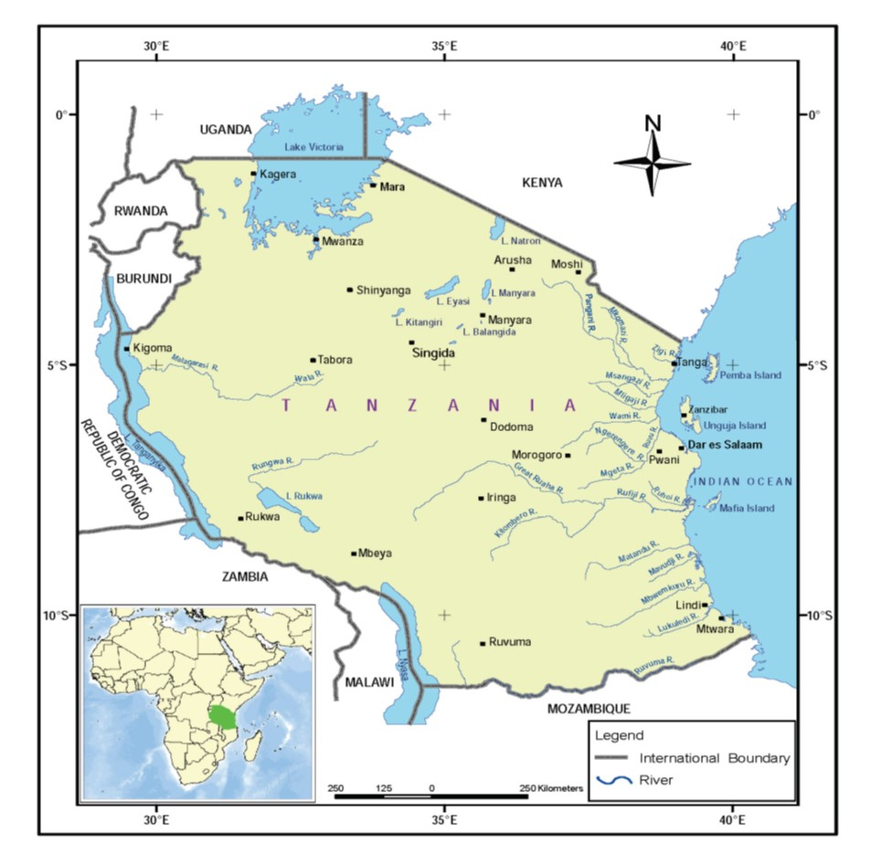
Introduction
Tanzania is a coastal state located in East Africa.
Location 1º and 12º S, and 30º to 40º E
Total land area is 945,040km²
Population: 60 million people.
Fisheries sector contribution to GDP is 1.8% in 2021
Coastline of 1,424 kilometers
Territorial Water is 64,000 km²
EEZ 223,000 km²

Slide 3
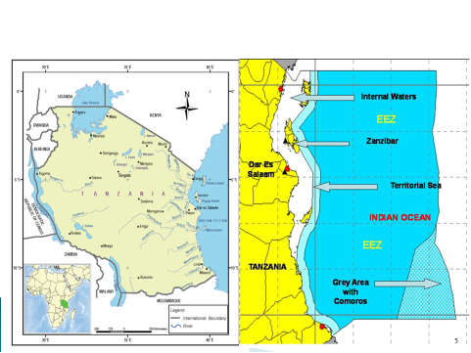
Introduction cont………
Maps of Tanzania showing the distribution of water resources; (Tanzania Map and Tanzania EEZ)

Slide 4
Climate Change, Impacts and Vulnerability in Tanzania
Evidences of changes in key climate variables have been observed in Tanzania, demonstrated by increase in frequency and intensity of extreme events such as:-
- Strong wind,
-Heavy rainfall,
-Storm, floods,
-Prolonged drought and
-Higher temperatures.
These have impacts on various reproductive sectors such agriculture, livestock and fisheries.
Observed heavy floods has also affected most of infrastructure facilities hence devastated livelihood and country economy as a whole.
Most of these extreme weather events including record breaking rainfall have been observed in the past five years (2015, 2016, 2017, 2018 and 2019).

Slide 5
Impact of Climate change on Coastal and Marine Environment
Coastal and marine ecosystems directly support the livelihoods of many Tanzanians.
Human activities coupled with the impacts of climate change have resulted into deterioration of these ecological systems.
Evidence of major climate change related impacts in Tanzania include destruction of coral reefs, coastal erosion, submergence of small islands, destruction of coastal infrastructures and human settlement, intrusion of sea water into freshwater wells, and degradation of mangrove and coral reefs.
Mangrove and coral reefs protect the shoreline and coastal land against ocean waves or surge effects.

Slide 6
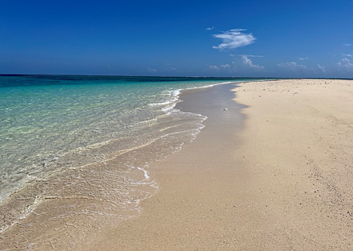
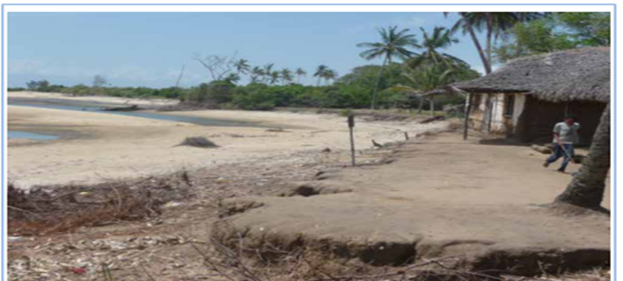
Climate Change Impacts
Sea level rise
is a major potential climate change impact. The evidence is the submerge of Maziwe Island in Pangani District, also the statistics shows that some parts of Zanzibar (20% Unguja and 30% Pemba) and Mafia are bellow 5 m above sea level.
Threaten mangrove ecosystems.
Sea level rise drives sea water on shore and push estuarine zone further upward thus affecting habitats and organisms intolerance to salinity
Submerged Maziwe island in Tanzania
Coastal erosion in Bagamoyo District

Slide 7
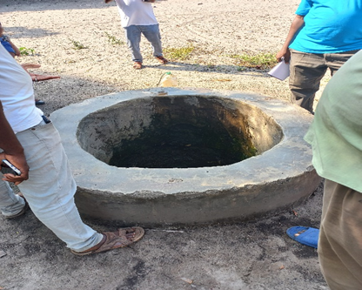
Climate Change, Impacts……….
Intrusion of sea water into freshwater wells.

Slide 8
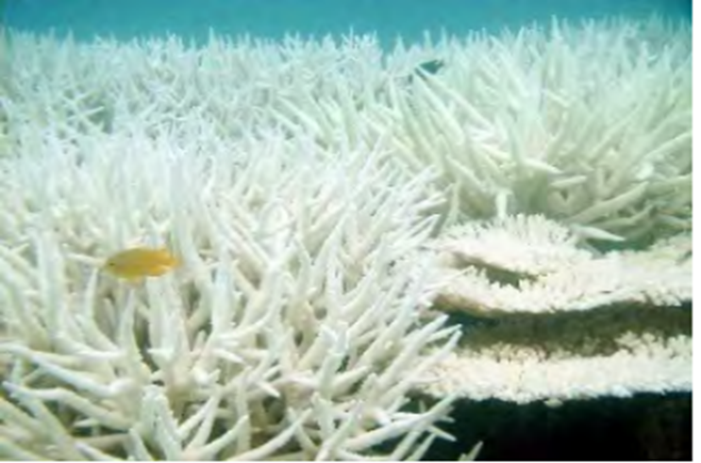
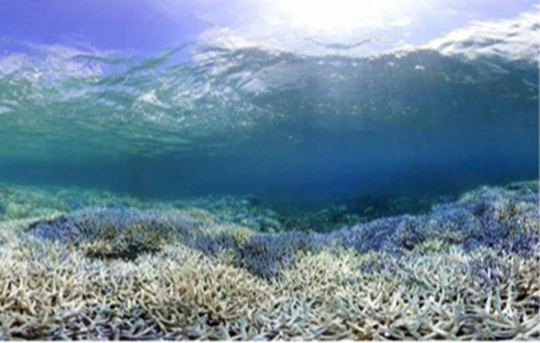
Climate Change Impact……
2. Coral bleaching
Resulted from elevated seawater temperature.
Coral reefs are very sensitive and vulnerable to Sea Surface Temperature (SST) rise than their optimal maximum temperature (27°C).
Impacts of coral degradation
Loss of biodiversity
Loss of aesthetic value
Bleached coral at Chumbe Island Zanzibar

Slide 9
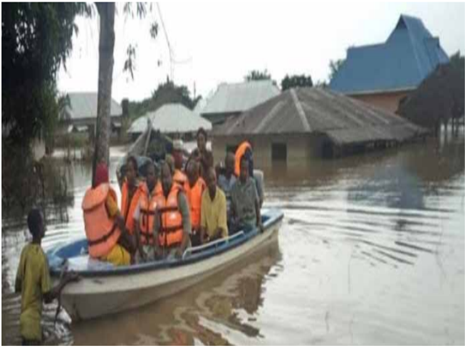
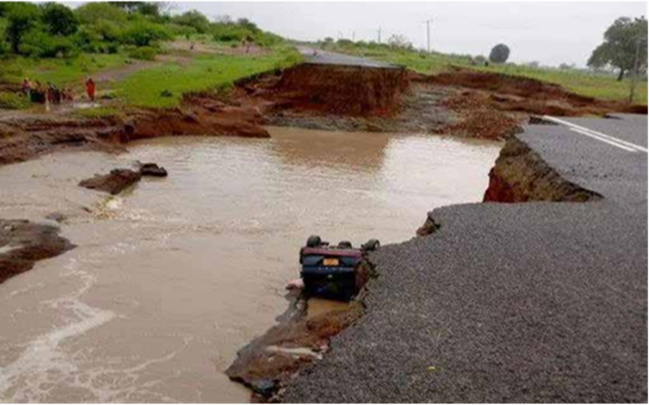
Climate change impact……………..
Heavy rainfall which courses floods in some parts of Tanzania.
Heavy rainfall also affects Road infrastructure
Effect of floods in Lindi Region-Tanzania
Road affected in Handeni District

Slide 10
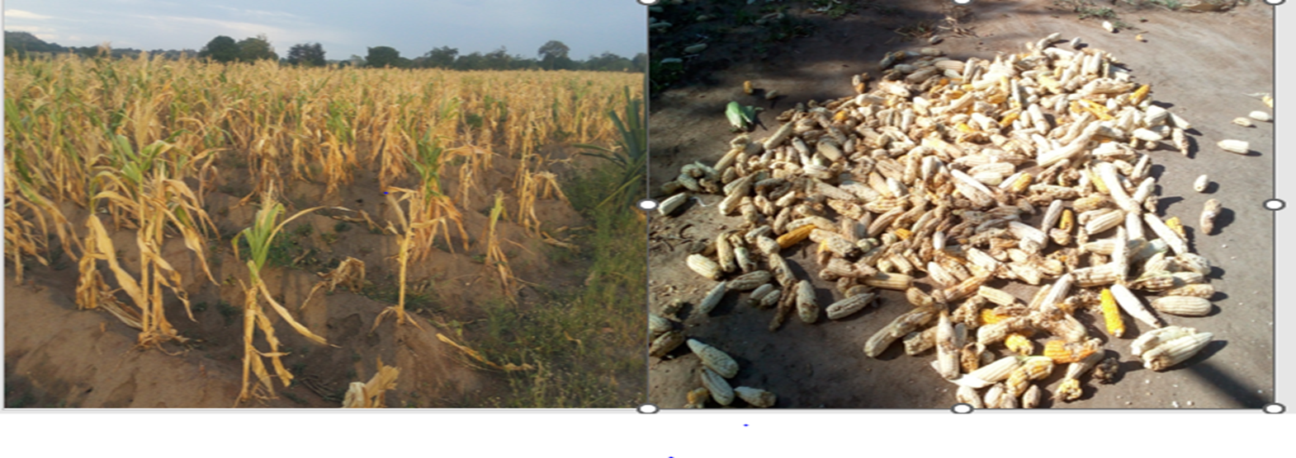
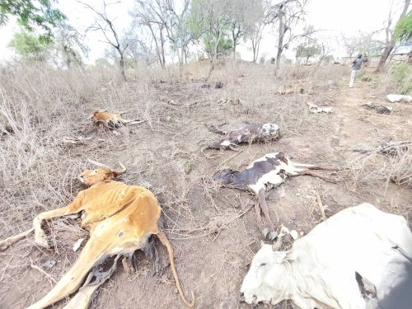
Climate change impact……………..
Frequent drougths affects production of maize crops.
Prolonged drought affects livestock
Grazing
Water
Busega District Tanzania in February 2017
Animals died in Northern parts of Tanzania

Slide 11
Interventions for addressing Climate change Impacts
Tanzania has been undertaking various efforts towards addressing climate change in accordance with its national context.
The National Climate Change Response Strategy (2021)
The Zanzibar Climate Change Strategy (2014)
These two strategies are comprehensively elaborate adaptation measures and mitigation actions that are deemed necessary to address climate change in the country.
Development and implementation of Nationally Determined Contributions (NDC) as per Paris agreements of the United Nations Framework Convention on Climate Change (UNFCCC).

Slide 12
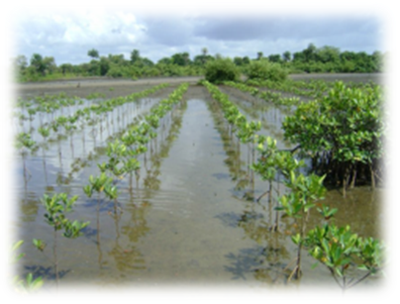
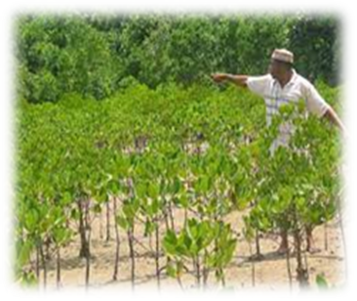
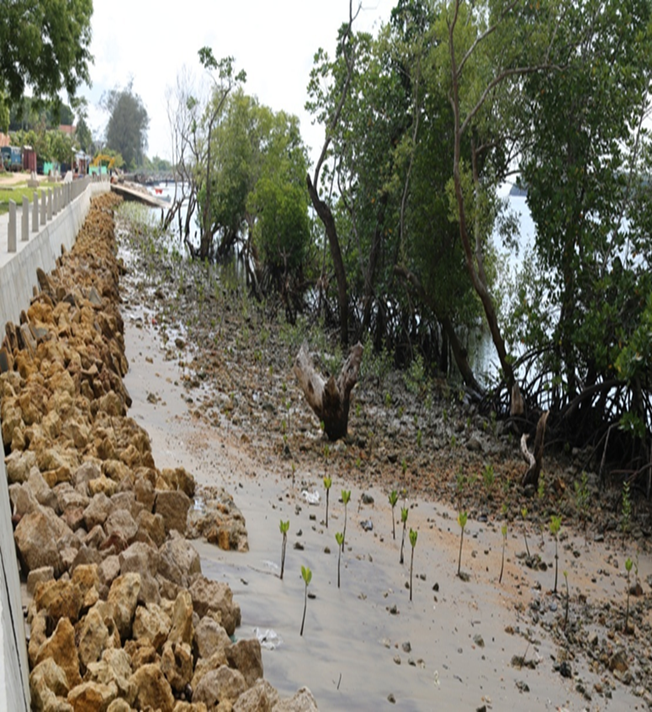
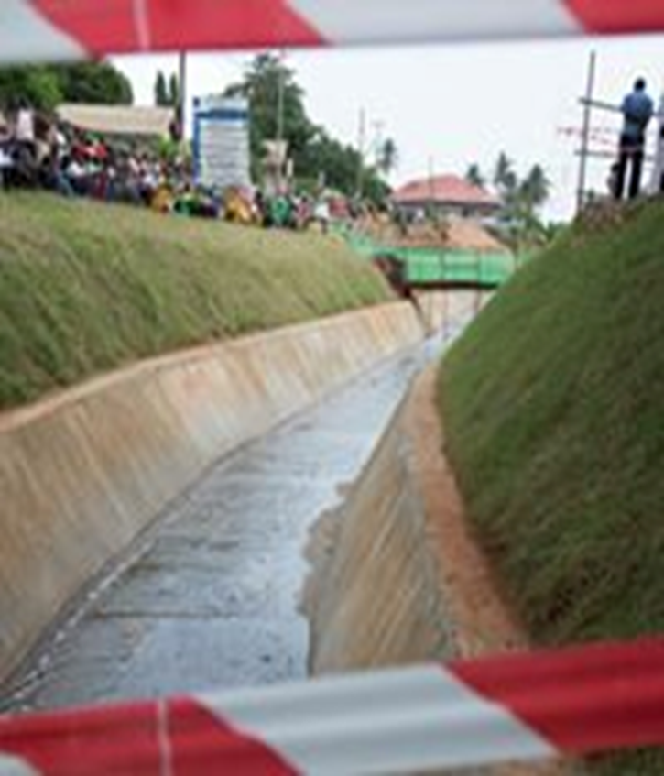
Interventions for addressing Climate change Impacts
Mangrove restoration.
Construction of sea wall and Storm water drainage.
Mangrove restoration at Rufiji Delta - Tanzania
Sea wall at Pangani-Tanzania
Storm water drainage at Temeke- Tanzania

Slide 13
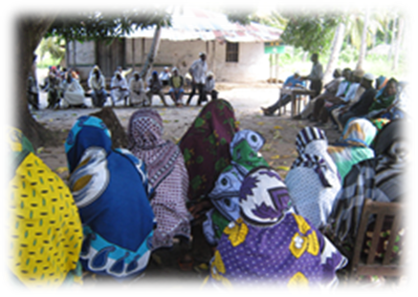
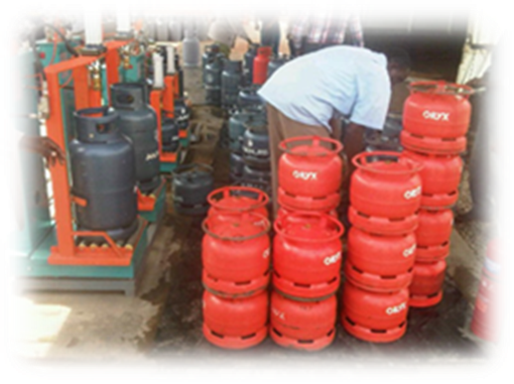
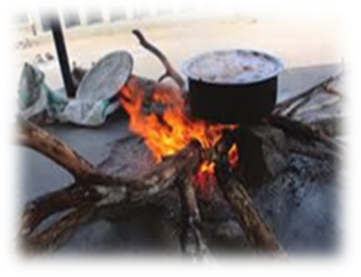
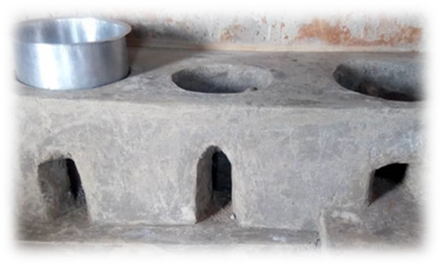
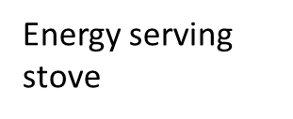
Use of energy serving stove
Awareness meeting with communities
The government have raised awareness to communities to use energy serving stove and use of gas for cooking so as to reduce the high dependence of fire wood.
Use of gas
Current situation in rural areas
Energy serving stove

Slide 14
CHALLENGES
Inadequate enforcement and compliance of various legislation related to environmental management;
Unplanned settlement in some areas;
Inadequate environmental research, data and information on environmental issues;
Inadequate funds for supporting the initiative for adaptation and mitigation to Climate change, its Impacts and Vulnerabilities;
Insufficient capacity building in environmental and climate change issues and
Inadequate alternative sources of energy and dependence on charcoal and firewood as the main source of energy.

Slide 15
CONCLUSION
Climate change poses substantial risks for Tanzania. While projected trends in rainfall are uncertain, there is a high probability of year-round temperature increase, as well as sea level rise.
The sectors potentially impacted by climate change include Fisheries, Agriculture, Forests, Water resources, Coastal resources, Human health, and energy, Industry and transport.
Given the low level of human development, extreme poverty, and high dependence on agriculture and natural resources, Tanzania may be quite vulnerable to projected climatic changes.

Slide 16
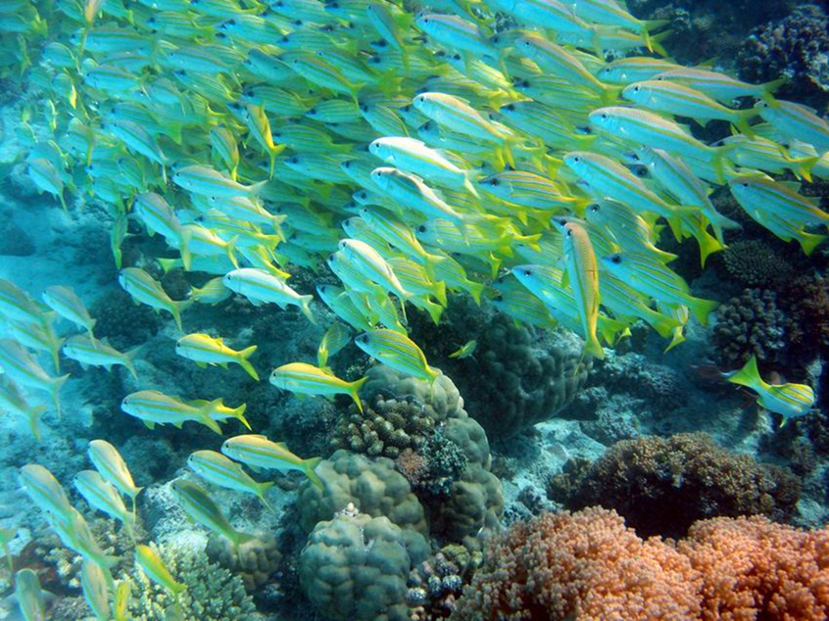
THANK YOU

