Slide 1
Critical Implications of Climate Change for Marine Migratory Species (sea turtles and tuna species – A REVIEW)
Terney Pradeep Kumara (Ph.D.)
Professor in Oceanography
Director,
Center for International Affairs (CINTA)
University of Ruhuna, Matara
Sri Lanka

Slide 2
Global tracking dataset from 36 species of Marine Megafauna

Slide 3
Global tracking dataset from 36 species of Marine Megafauna
RESPONSES TO OCEAN TEMPERATURE
WINTER - SUMMER

Slide 4
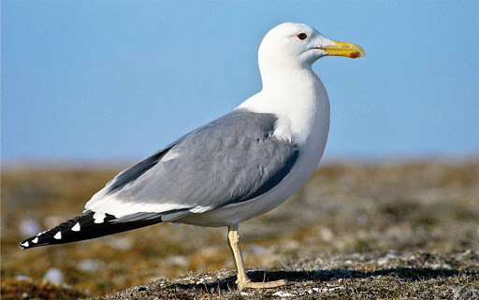
Heuglin’s Gull (Larus heuglini)

Slide 9
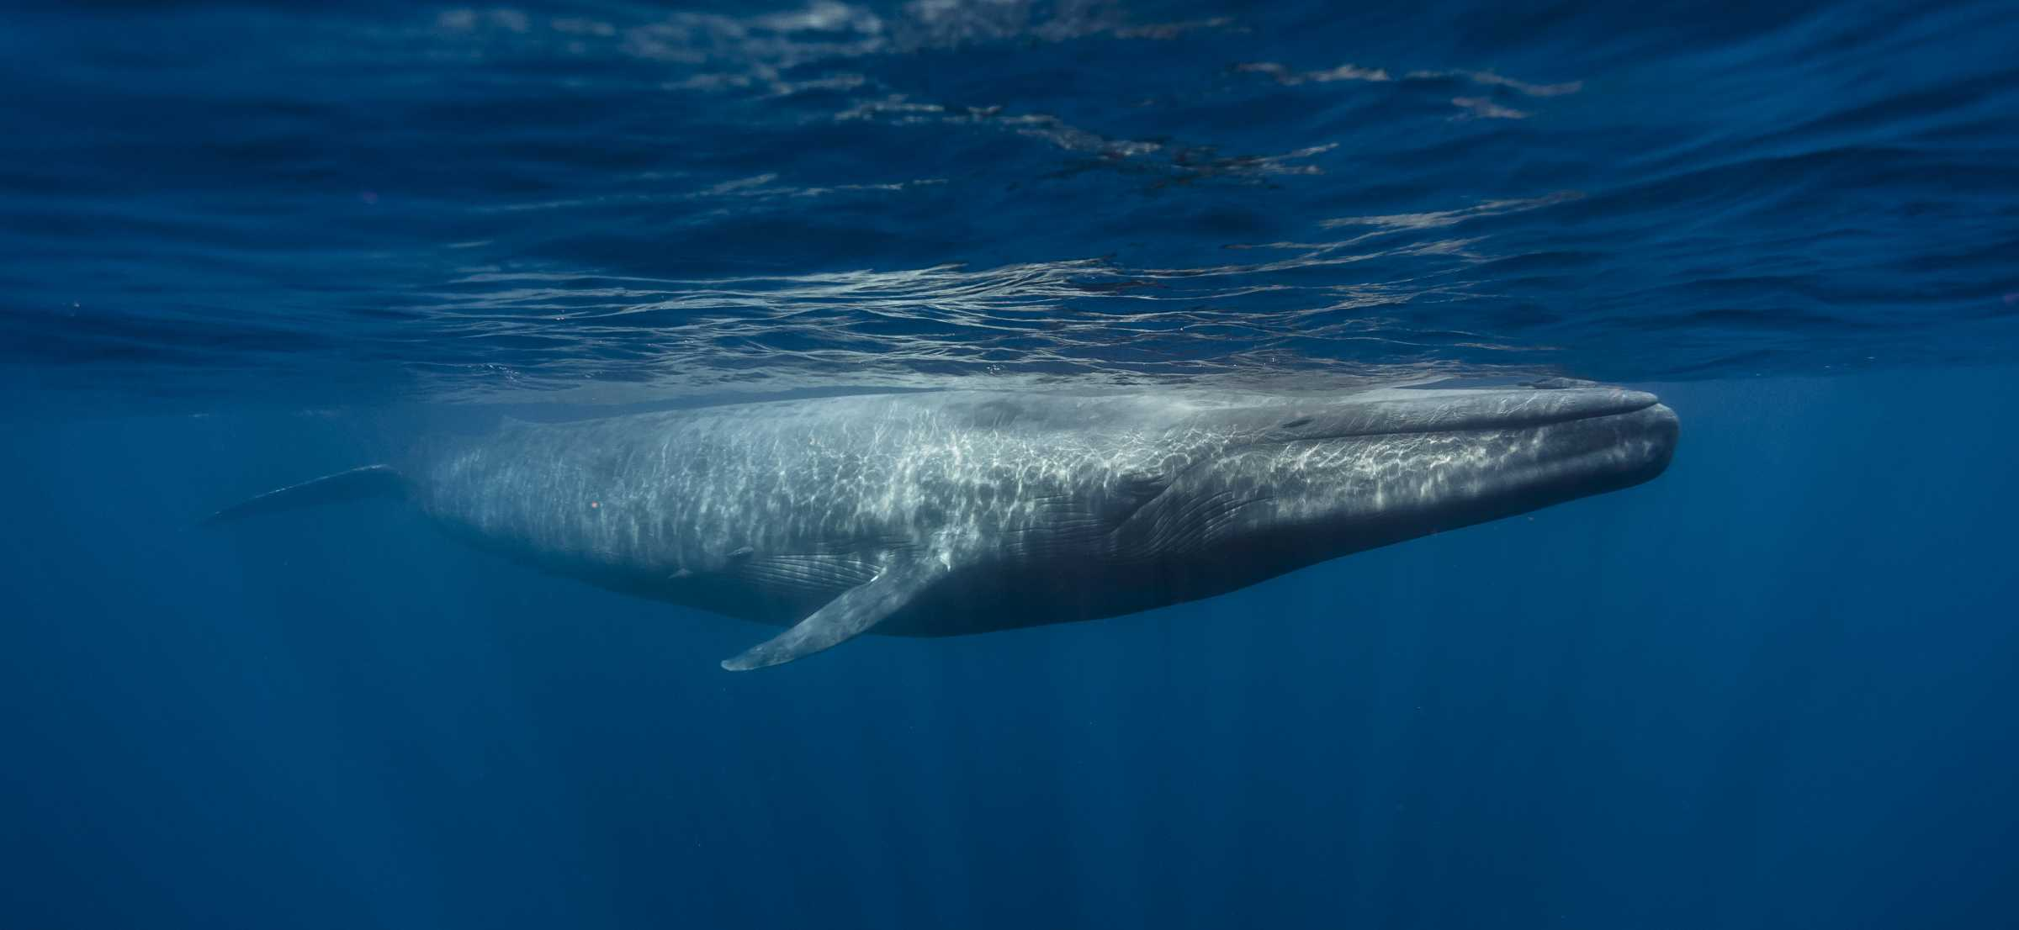
More than 80% of earth’s marine life is migrating to different places and changing their breeding and feeding patterns due to warming waters.
Notes:
http://www.carefordolphins.net/en/index.php?cat=h&pge=h14

Slide 10
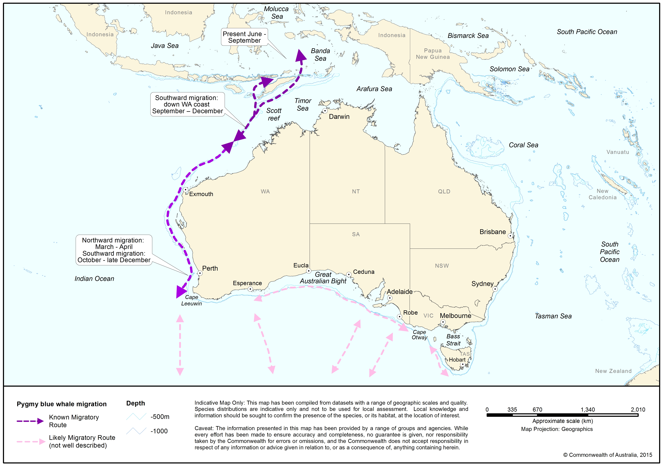
Notes:
http://www.environment.gov.au/cgi-bin/sprat/public/publicspecies.pl?taxon_id=36

Slide 11
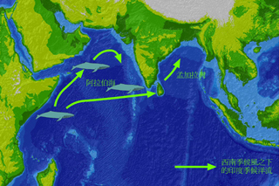
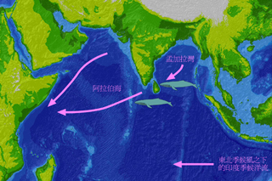
From May to October each year, the south-west monsoon prevails in the Indian Ocean and push surface sea water in the Arabian Sea of eastern Africa eastward. Part of the current passes through Sri Lanka and enters into the Bay of Bengal . This forms the Indian Monsoon Current. From December to March, this oceanic current reverses with the approach of the north-east monsoon and flows westward to the Arabian Sea

Slide 12
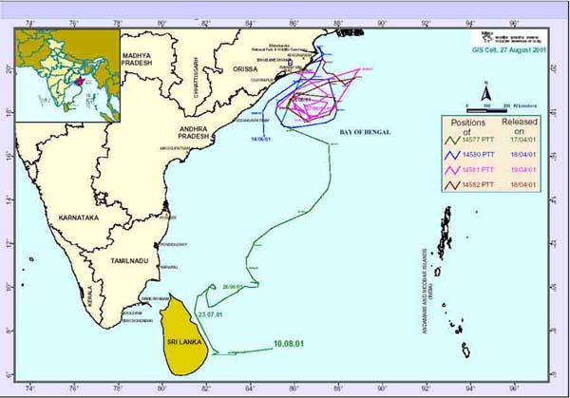
Satellite tracking of olive ridley turtles on the Indian

Slide 13
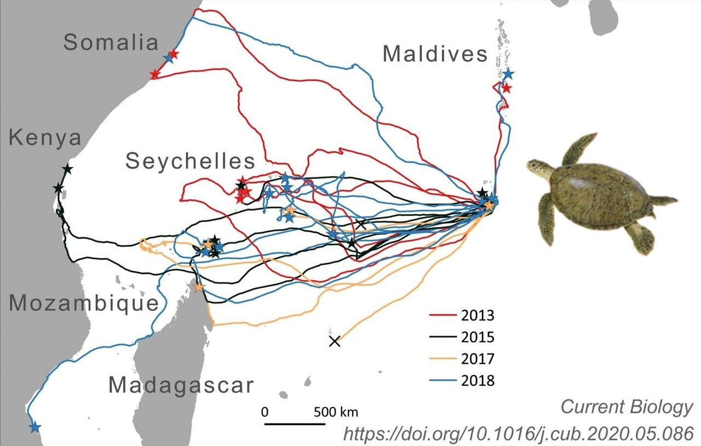
Green sea turtle – environment, food & breeding
Notes:
Chagos archipelago, Diago Garcia

Slide 16
In 1983, the Convention on the Conservation of Migratory Species of Wild Animals,
known as the Bonn Convention or CMS for short, went into effect.
Whether a species lives on land, in the ocean, in fresh water, or flies in the sky, if it migrates and is at risk, it could be eligible for listing under the CMS.
132 of signatory states
Species listed under the convention are placed into one of two Appendices
(or sometimes both).
These Appendices guide what sort of protective measures should be implemented by States
Notes:
In Manila on October 28, 2017, the 12th session of the CMS, signatory States (there are 129 of them) voted to add 33 migratory species to the CMS.

Slide 17
Appendix I
Reserved for the most threatened species - those in need of immediate and effective conservation to prevent their extinction.
States that have an appendix I species in their jurisdiction are responsible for ensuring the species is strictly protected.
This means that they have to conserve and restore the animals' habitat, remove any obstacles that might stop the animals migrating, and prohibit any take of the animals.

Slide 18
Appendix II
Is for those species that are threatened, but not as critically as those in Appendix 1
These species will also benefit from some targeted conservation actions to prevent their populations getting into an even worse condition.
Signatory States may want to apply some of the strong protection as they would if the animal was listed under Appendix I,
but the main focus is for States to cooperate with each other to ensure their animals are protected.
Agreements can be legally binding agreements between States, or they could be less formal agreements or even action plans.

Slide 20
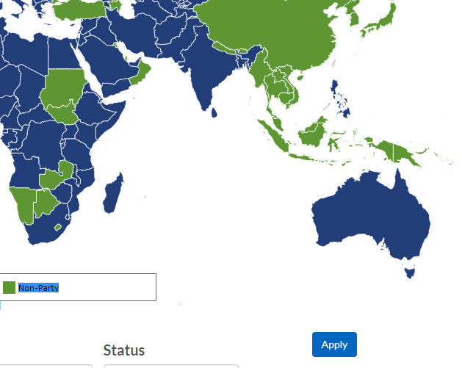
Myanmar, Thailand, Indonesia, Oman – Non parties

Slide 21
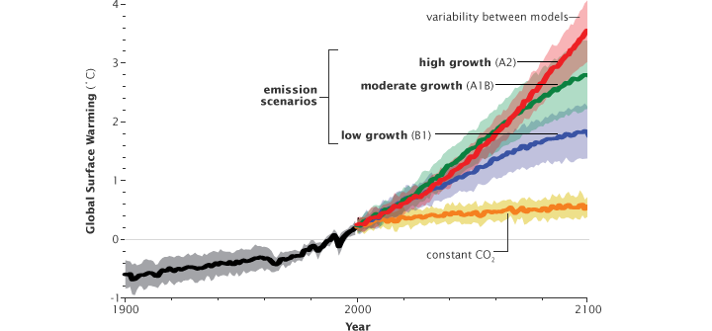
Climate change

Slide 23
Ocean species are migrating in response to a changing climate 10 times faster than land species.
Some marine species have migrated as much as 600 miles from where they were abundant just a few decades ago.

Slide 24
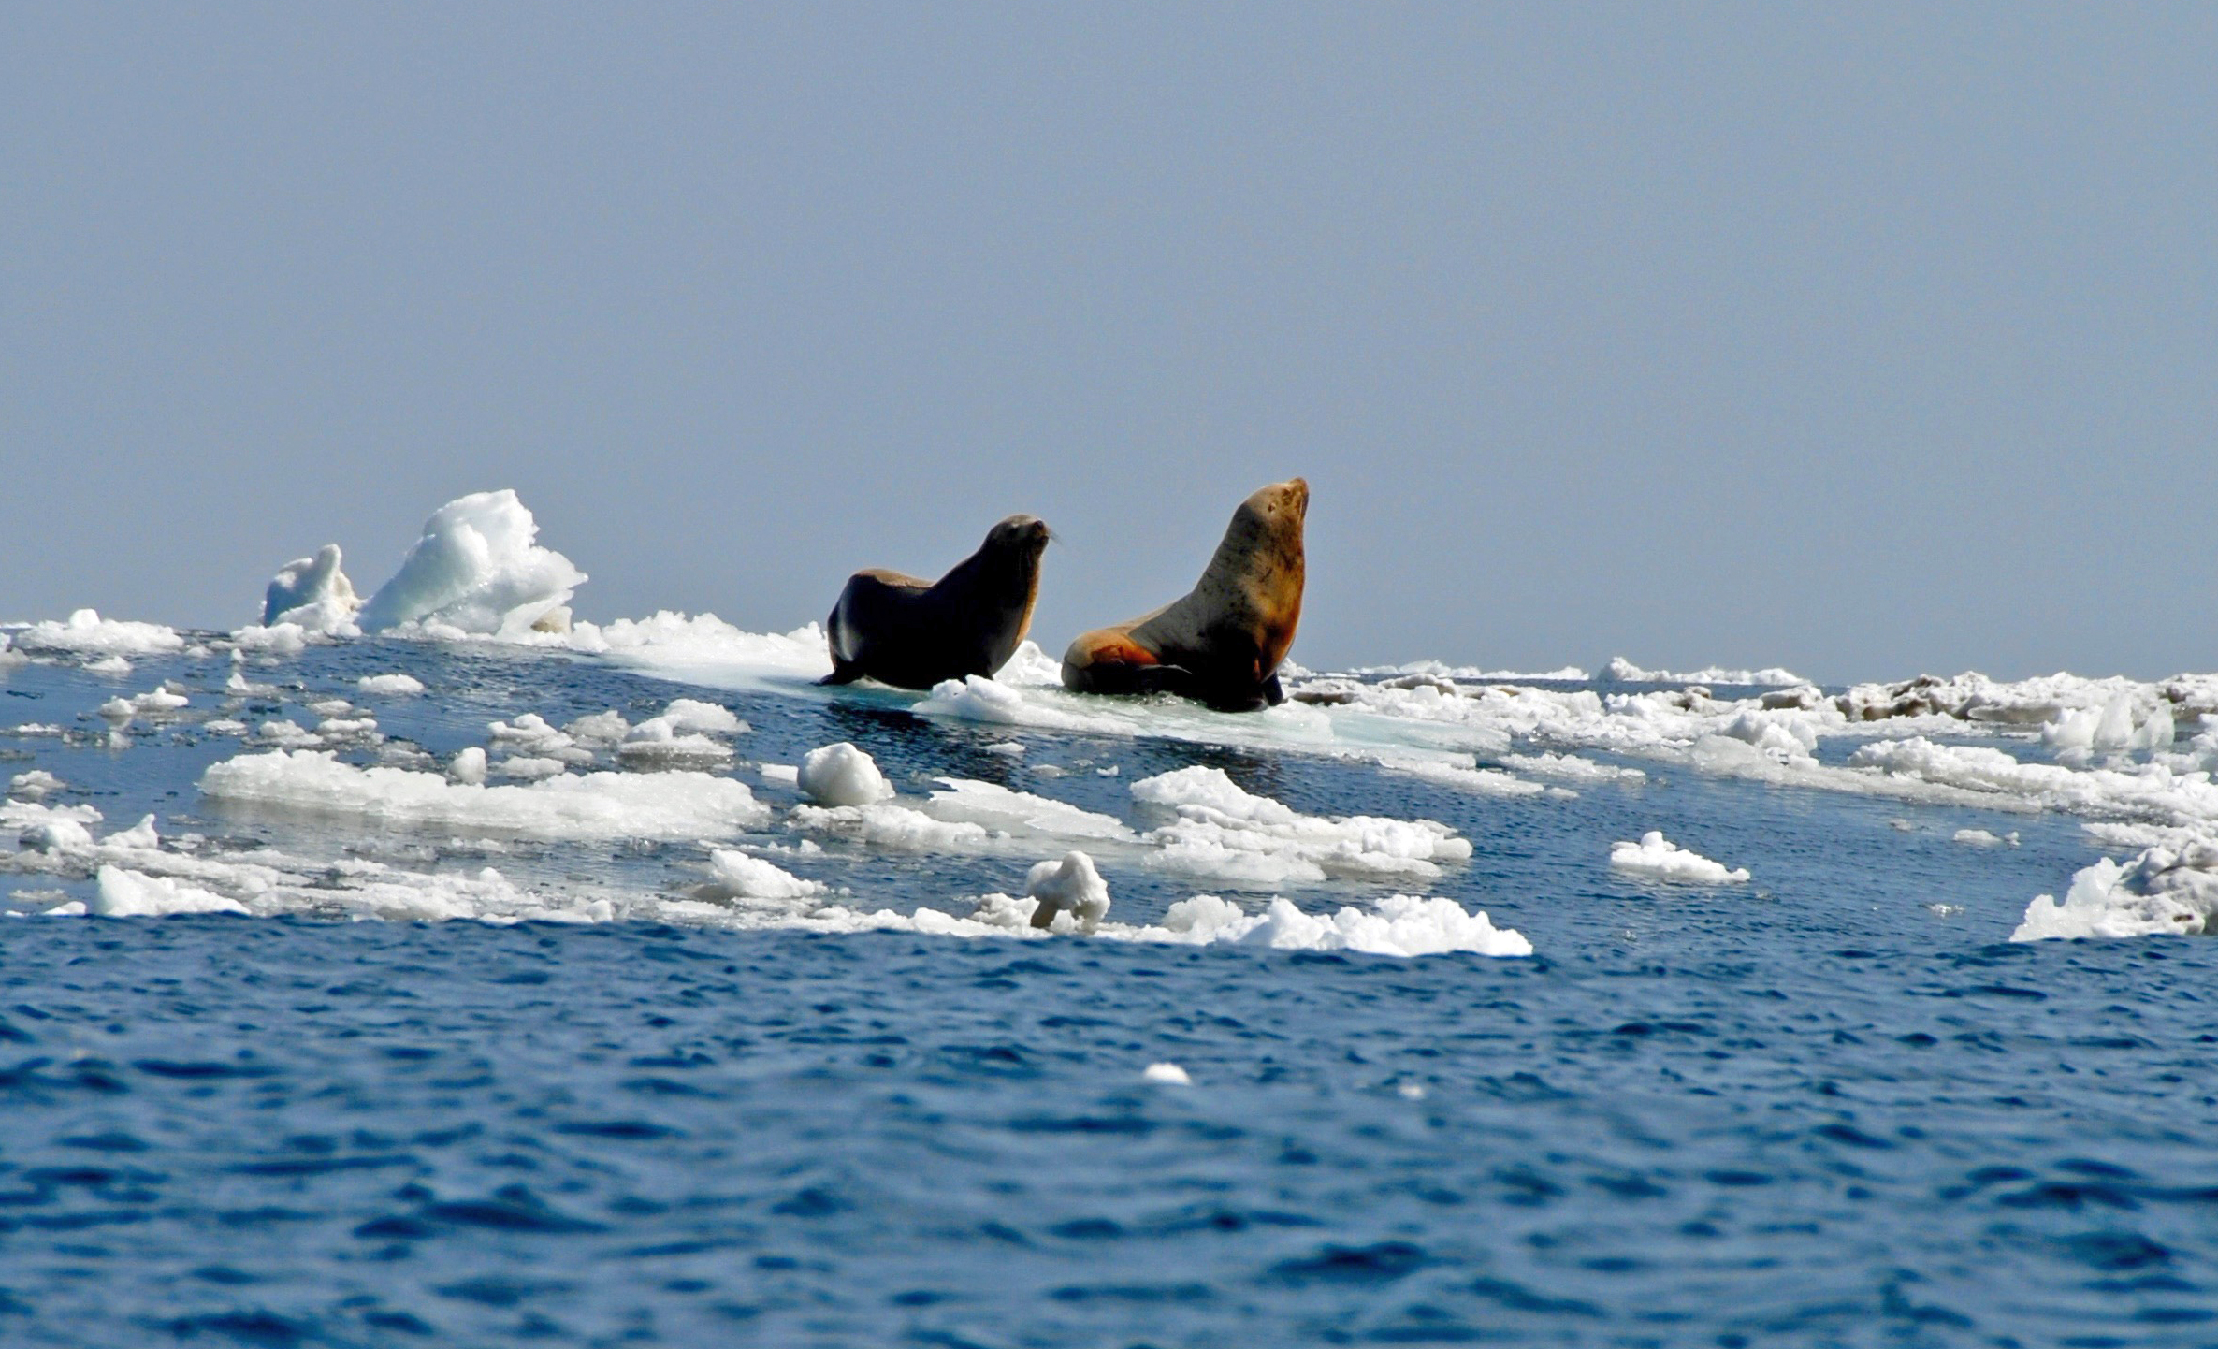
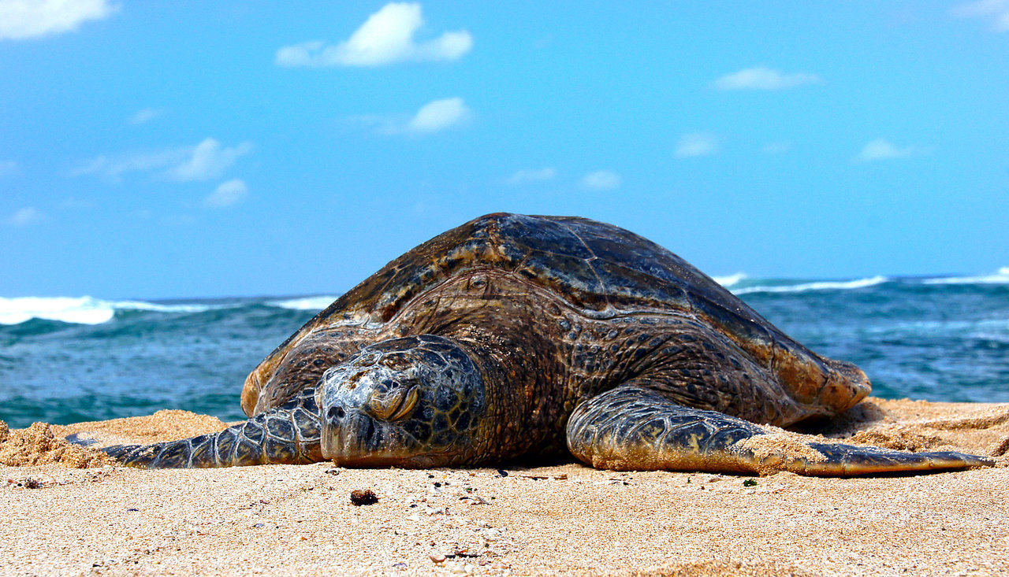
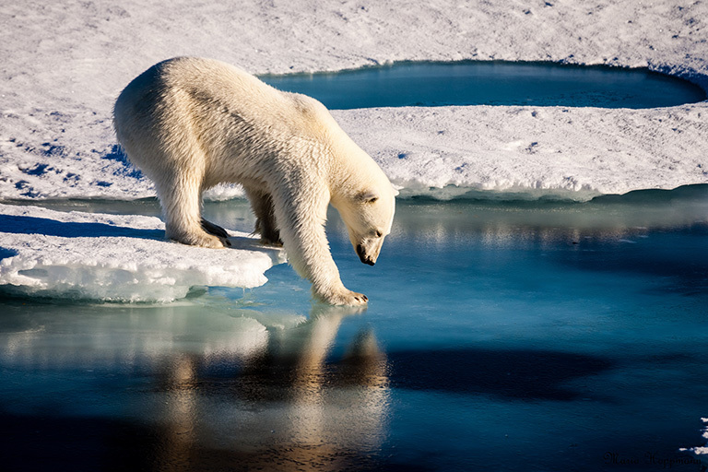
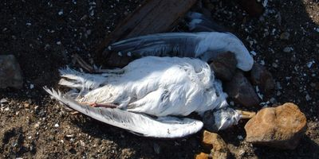
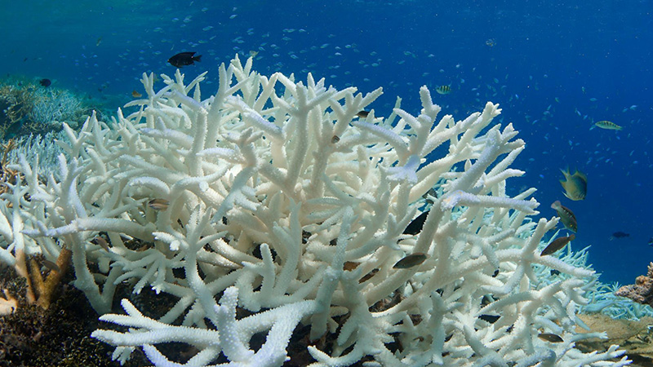
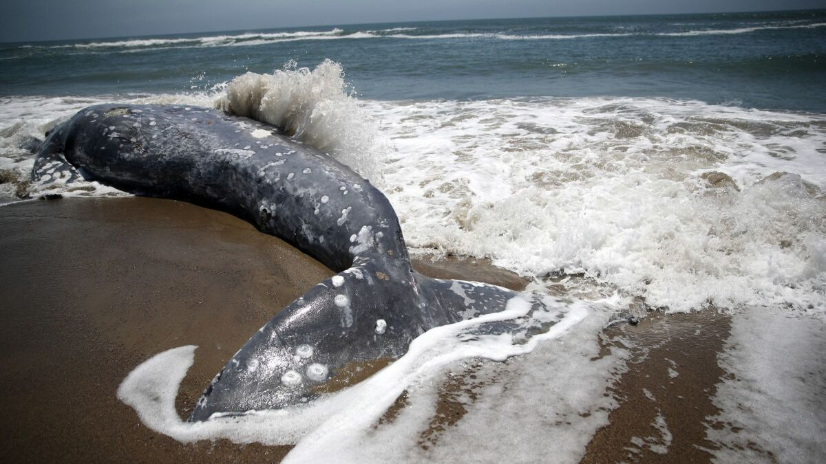
Threats to Marine organisms due to climate change

Slide 25
Impacts on turtles
Turtles are one of the most threatened groups of vertebrates.
According to the International Union for Conservation of Nature (IUCN) Red List,
62.8% of chelonians (162 of 258 species) are either critically endangered
(19.4%; n = 50), endangered (17.4%; n = 45) or vulnerable (30.0%; n = 65)
Although the seven species of sea turtle, represent approximately only 2% of the existing chelonian species
Chelonia mydas,
Caretta caretta,
Eretmochelys imbricata,
Dermochelyis coriacea,
Lepidochelys kempii,
L. olivacea, and
Natator depressus)

Slide 26
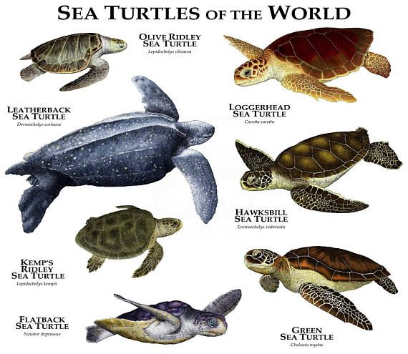

Slide 27
The threats facing turtles are varied and include
habitat alternation or loss,
overexploitation,
predation,
invasive species
diseases, and
climate change

Slide 28
Anthropogenic climate change could conceivably affect each of the following levels,
with effects on individuals - populations - communities.
Anthropogenic climate change could affect individual growth rates, fecundity, reproductive phenology , sex ratios via temperature-dependent sex determination, and predation rates.

Slide 29
Poikilothermic animals, may be particularly susceptible to the effects of anthropogenic climate change.
In addition, Turtles has limited vagility and may not be able to keep pace with forecasted climatic changes
Although turtles have survived previous periods of climate change, the existing rate of change is far more rapid and turtles may not be able to respond in time, due in part to their long generation times

Slide 30
Climate change could conceivably modify resource availability, reducing or changing the prey base and affecting individual growth rates or survivorship.
One notable exception is a study that found that a heat wave in 2010/2011 in Australia caused a 90% reduction in the amount of sea grass in some areas, which was linked to reduced health in green sea turtles for up to two years following the event
SEA GRASS vs GREEN SEA TURTLES

Slide 32
The impacts of climate change may vary depending upon the life-history stage;
Embryonic development are influenced by hydrology and T while they are in the nest.
In addition, phenotypic and behavioral plasticity could also potentially ameliorate or mitigate the effects of climate change.
For example, an individual could modify the date of egg-laying in response to warmer temperatures

Slide 33
There are several studies about how temperatures affect adult sea turtles.
For example, wintertime dive duration in loggerhead turtles is inversely related to sea surface temperatures, and they may adopt a “sit-and-wait” strategy with limited surfacing during periods of cold temperatures.
Some sea turtle species will also make seasonal trips to forage in areas that are only thermally suitable on a seasonal basis.
In addition, if water temperatures drop below 10 C, sea turtles may experience “cold stunning”, which can be lethal

Slide 34
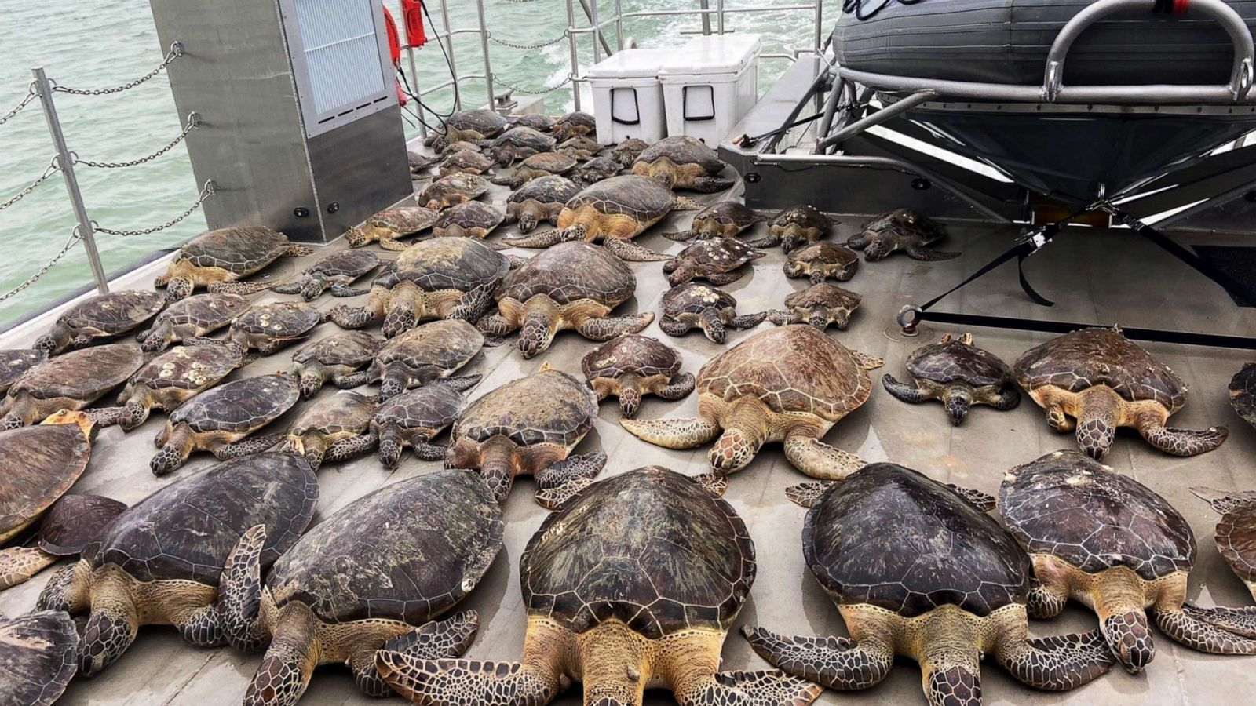

Slide 35
Of the existing research regarding the effects of climate change on individuals, the majority of effort has focused on nest-site selection and its effects on egg development.
Nest-site selection influences the thermal environment for the developing embryos, which can affect embryo survivorship and the sex of the offspring (High T - LOW Hatching)
In addition, it was also suggested that developing embryos can reposition themselves within the egg to take advantage of warmer temperatures – contested
Additionally, the rapid growth of embryos means that internal egg space rapidly diminishes, and muscle development is insufficient during the resulting narrow temporal window for behavioral thermoregulation

Slide 36
Temperature and precipitation can affect growth rates of hatchling chelonians, and climate change could potentially negatively impact these rates.
For example, warmer temperatures can influence post-hatching growth rates, with warmer temperatures resulting in slower growth
In addition, climate change may also affect hatchling survivorship –
Higher T - lower survival, Vice versa for some spp

Slide 37
Population-level impacts of climate change could include expansion or contraction of distributions, changes in sex ratios, changes in survivorship, and increases or decreases in fecundity and recruitment.
Additionally, anthropogenic climate change could reduce access to nesting substrates.
Phenological changes, such as the timing of reproduction, could also potentially occur

Slide 38
Eg.
At a fine scale there was a slight northward shift in loggerhead sea turtle (Caretta caretta) nest placement along Melbourne Beach, Florida
Kemp’s ridley historically nested along approximately 1000 km of beach in Mexico, but have now been observed laying eggs as far away as the Atlantic coast of Florida, more than 1700 km distant, due to warmer conditions.
the distribution of the leatherback sea turtle is tied to the 15 C isotherm in the North Atlantic, and the summer position of this isotherm has shifted north by more than 330 km

Slide 40
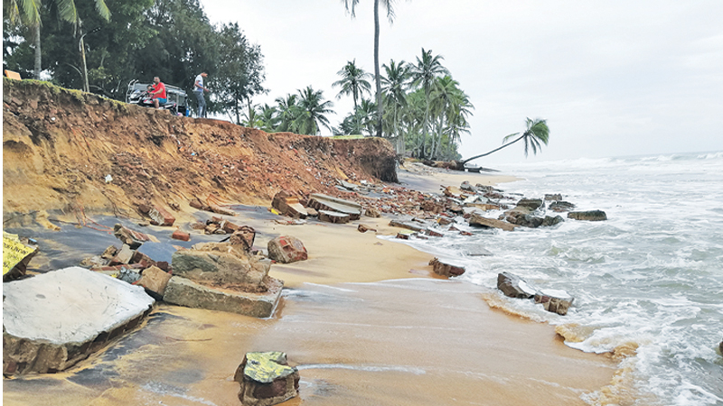

Slide 42
Climate change could conceivably affect Temperature-dependent Sex Determination (TSD), although the pattern of TSD in turtles is variable
(some species exhibit genetic sex determination)
There are three types of TSD:
(1) Low temperatures result in females, while high temperatures result in males - FM XXX
(2) low temperatures produce males while high temperatures produce females - MF
(3) low temperatures result in females, medium temperatures result in males, and high temperatures result in females - FMF
The pivotal temperature is the temperature at which the ratio of male to female turtles is 1:1 for species that exhibit TSD
some species exhibit geographical variation in the pivotal temperature between male and female offspring

Slide 43
warmer temperatures may exceed the pivotal temperature and are most frequently linked with an increase in feminization
For example,
Green sea turtles reproducing in the northern Great Barrier reef have become extremely female-biased during the past two decades and this population is at risk of becoming completely feminized in the near future .
In the Caribbean, green sea turtles, hawksbill, and leatherback turtles have had female-biased hatchling sex ratios for at least the last century, and it is anticipated that climate change will further exacerbate this skew

Slide 44
There is also evidence that temperatures play a role in seasonal movements.
Hawksbill sea turtles in the Persian/Arabian Gulf temporarily emigrate from the area during the hottest summer months of June through August when the sea surface temperature averages 33.5 C and return when temperatures begin to cool down during September and October

Slide 45
Climate change and marine turtles: recent advances and future directions Ana R. Patrício, Lucy A. Hawkes, Jonathan R. Monsinjon, Brendan J. Godley, Mariana M. P. B. Fuentes A Review of the Effects of Climate Change on Chelonians Christopher J. Butler
There is also evidence that increasing temperatures impact abundance, nesting phenology, and intervals between successive nesting seasons for hawksbill turtles in the southern Gulf of Mexico.
For example, sea surface temperatures (SSTs) for Pacific loggerhead foraging areas have steadily increased since 1955 and nesting abundance at rookeries declined as temperatures increased

Slide 46
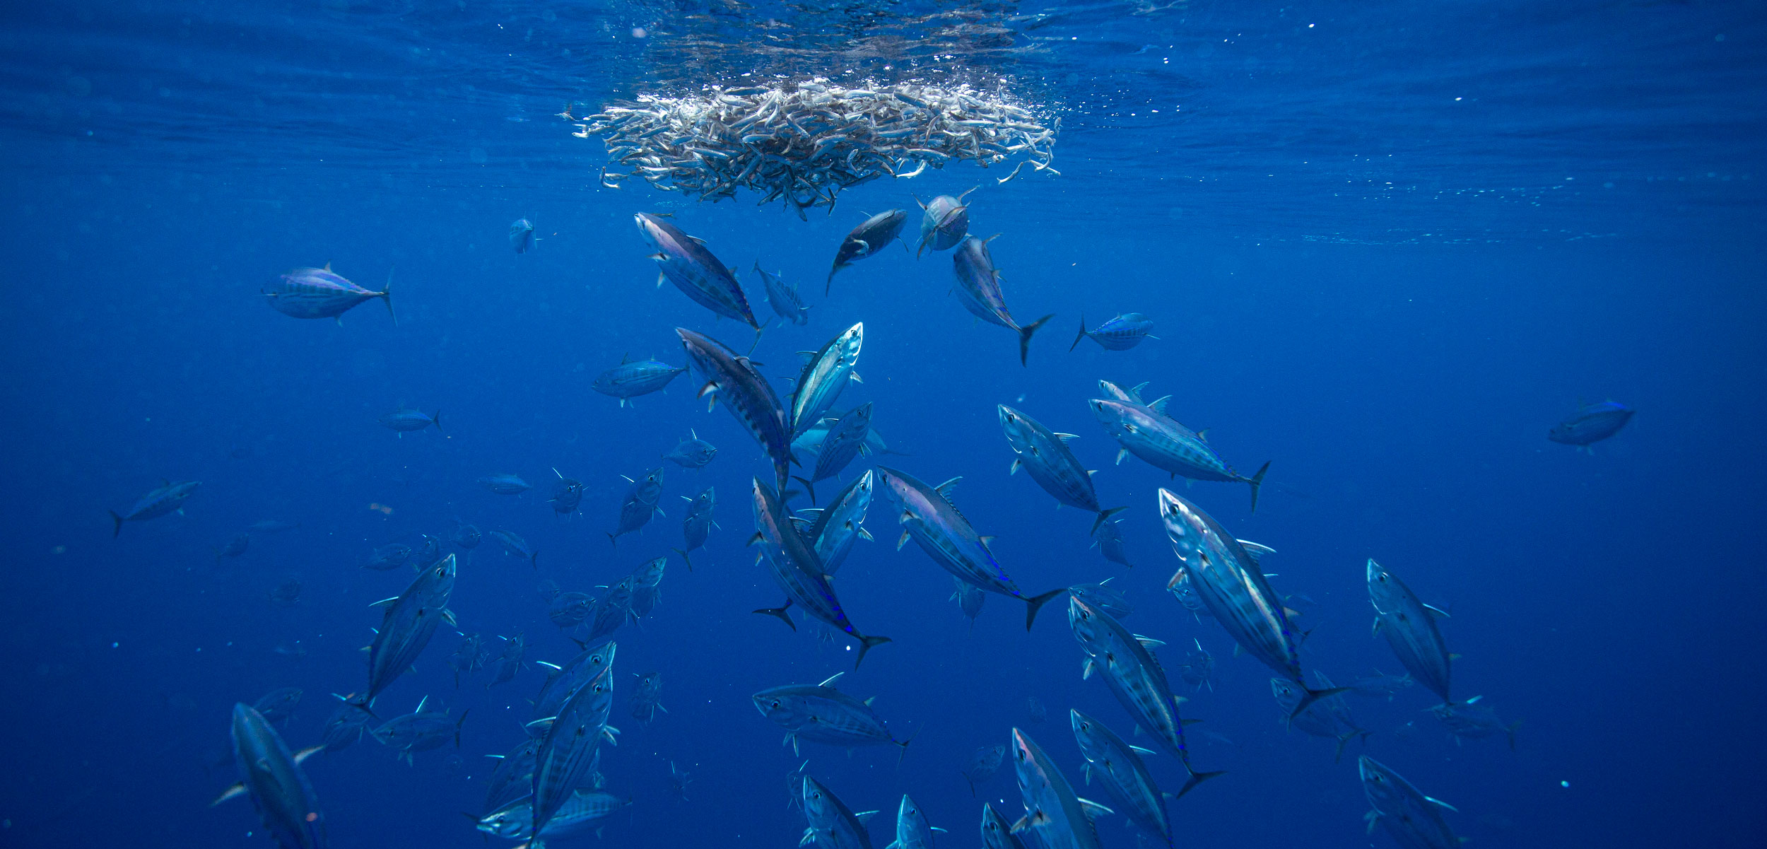
Impacts on tuna

Slide 47
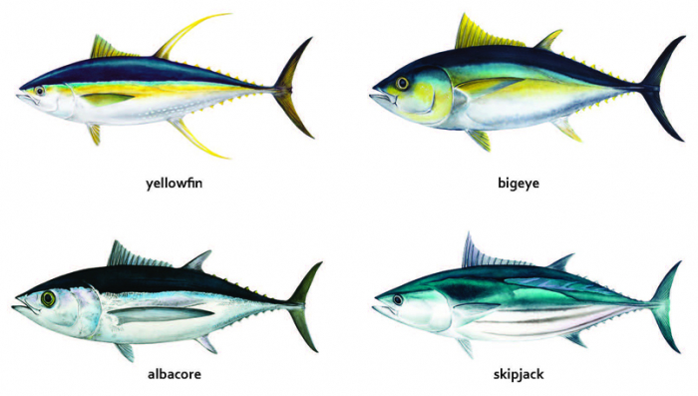

Slide 48
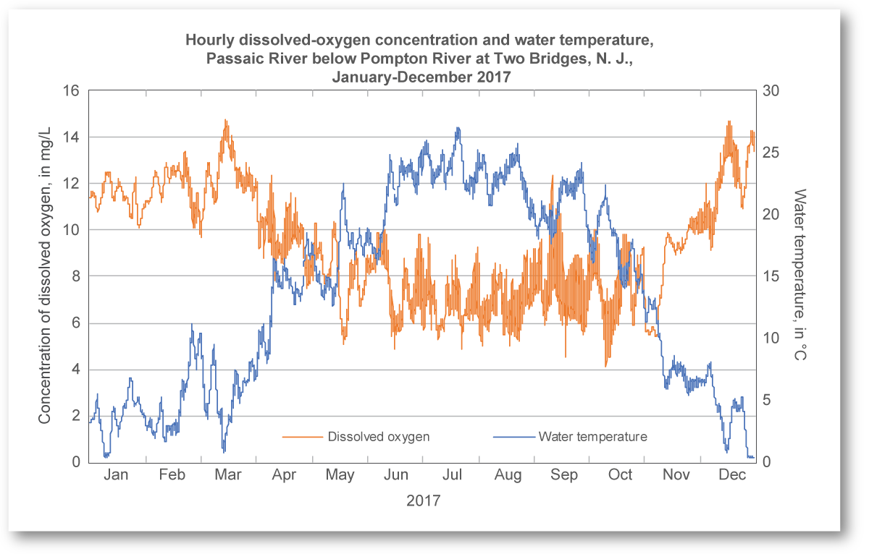
Increased water temperature
For each degree of ocean warming, oxygen concentration goes down by 2 percent.
Over the short term, the higher T slow the rate of ocean circulation, exacerbating regional O₂ depletion.

Slide 49
Effects of temperature on tuna

Slide 50
Effects of oxygen on tuna

Slide 51
Suitable areas for BFT larvae may shift up north by 2050, and occurrence of BFT larvae in GOM may decrease in late spring by 39–61% by 2050, with higher decrease in May–June and higher increase in March–April.
Water T > 28–30 °C may affect BFT and YFT eggs and larvae survival and development
Water T > 30 °C reduces BFT and YFT cardiac functionality making spawning adults more vulnerable to overheating and hypoxia
Water T increase leads to higher metabolic stress in BFT, which may cause enhanced post-release mortality from fishery (e.g., longline)

Slide 52
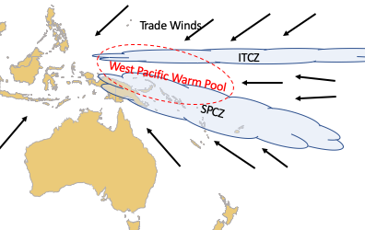
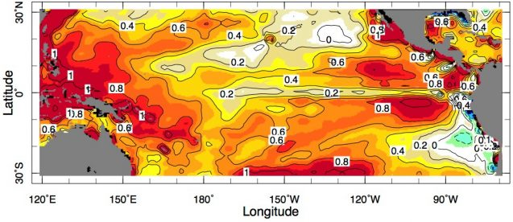
An eastward shift in the distribution of Yellowfin tuna was observed in Pacific Ocean
Notes:
South Pacific Convergence Zone (SPCZ)

Slide 53
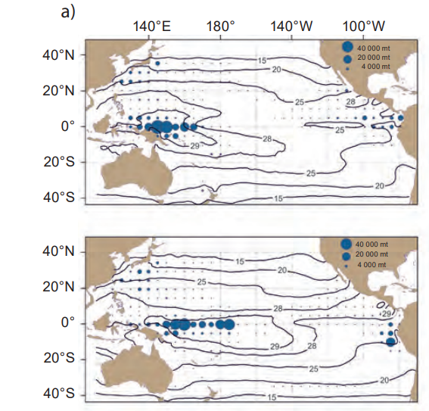
Effects of ENSO on the location of the Warm Pool (28–29°C) and distribution of skipjack catch.
Skipjack tuna catch (tonnes) and mean sea surface temperature (°C) in the tropical Pacific Ocean during the first half of 1989 (La Niña period), and
in the first half of 1992 (El Niño period),

Slide 54
Sea surface temperatures in the central and east equatorial Pacific are expected to warm more than those in the west.
However, the size of the Warm Pool (as defined by the 29°C isotherm) is projected to increase by 230–250% by 2035 under B1 and A2,
448% and by 480% under B1 and
770% under A2 in 2100

Slide 55
Water T increase may lead to change in vertical distribution (i.e., increased utilization of deeper water) in BUM, although light and [O2] might be key limiting factors
Water T increase will lead to higher negative impacts for breeding BFT than for YFT and SKJ
(Water T increase may favor larval stages of SKJ compared to other tuna)
Water T increase facilitates hypoxia, which can affect YFT eggs and larvae survival and growth rate
Water T increase in the north Atlantic (feeding ground of BFT) may alter prey quality and adult BFT growth rate

Slide 56
Effects of oxygen on vertical distribution of tuna

Slide 57
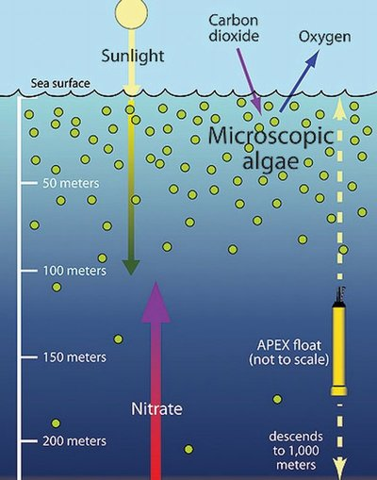
Changes in precipitation
Increased freshwater run-off will lead to higher primary productivity in coastal areas, which may lead to higher predation rate on tuna and BIL eggs and larvae
Increased freshwater run-off will lead to decreased BIL and SWO larval survival in water mixed with coastally derived water masses with lower salinity and higher T

Slide 58
Hypoxia can affect tuna eggs and larvae survival and development
Decreased [O₂] can delay hatching in BFT and YFT eggs
Hypoxia can enhance metabolic stress in BFT and BIL, which may cause enhanced vulnerability and post-release mortality from fishery (e.g., longline)

Slide 61
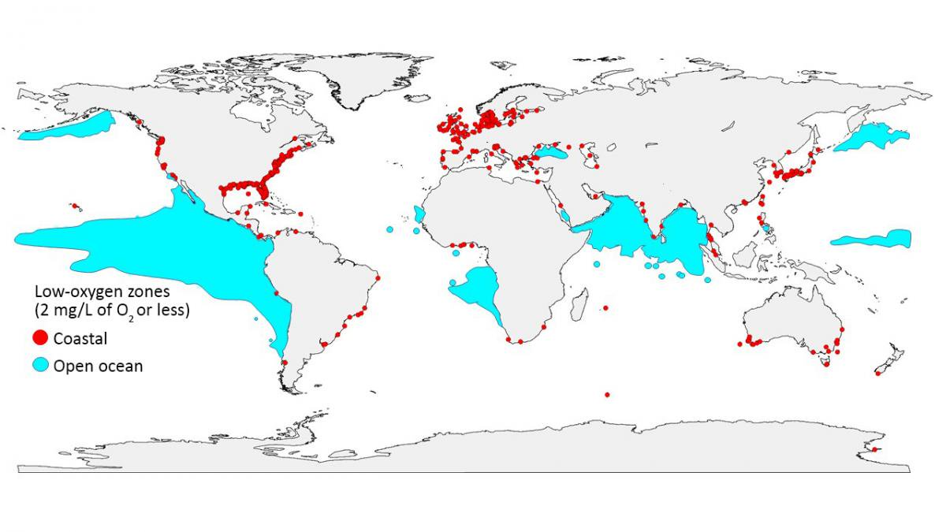

Slide 62
Spreading (horizontally and vertically) of hypoxia may reduce acceptable habitat (habitat compression) for BUM and BIL
Habitat compression may enhance foraging opportunities for BUM due to Goodyear, 2006 similar habitat constrain in their prey in near surface waters
Changes in [O2 ] may limit the depth of acceptable habitat for BIL and tuna (hypoxic threshold for tuna and BIL considered
Hypoxia can affect cruising speed in SKJ, and HMS, and affect their feeding rate (hypoxic threshold for tuna and BIL considered as < 3.5 mL L−1=4.7 mg L−1 and YFT found to rarely move in waters with [O2] concentration < 5.7 mg L−1)

Slide 63
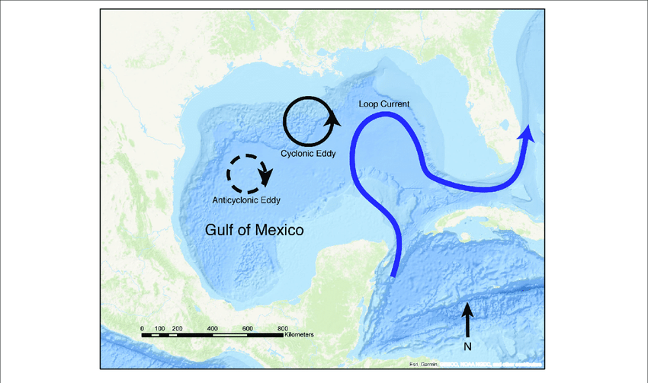
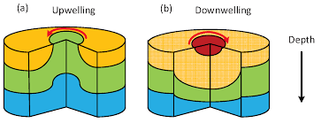
Changes in ocean circulation
Potential reduction in the Loop Currents influence to form warm anticyclonic eddies may reduce survival of eggs and larvae in BFT and BIL in the northwestern GOM by 2050

Slide 64
Increased ocean acidification
Changes in eddy kinetic energy by 2050 will likely affect the breeding behavior of BFT
More acidic waters (decreased pH) alter olfactory functions in SHK and Fish
Increased ocean acidification will impact YFT eggs hatching time and larvae survival and growth
Research results suggest that the acidification impact will be smaller in comparison to the ocean warming impact,

Slide 65
Changes in storm and wind patterns
Changes in microturbulence might affect BFT and YFT larval feeding rate and growth
Increased frequency of more intense storms between June and September will likely affect survival of YFT and BIL larvae, and will likely be less impacting for BFT larvae (spawning occurs between March and June)
Hurricanes can amplify negative effects of increased precipitation (e.g., hypoxia, higher productivity and predation on larvae) and cool-down water temperature too fast, which will likely affect survival of tuna and BIL eggs and larvae
Potential medium-term impacts of climate change on tuna and billfish in the Gulf of Mexico:
A qualitative framework for management and conservation
Andrea Dell’Apaa, Karen Carney, Theresa M. Davenport, Melissa Vernon Carle
Notes:
GOM=Gulf of Mexico, LC=the Loop Current, T=Temperature,
[O2] Dissolved oxygen concentration, BFT = Atlantic bluefin tuna, YFT = Yellowfin tuna, SKJ = Skipjack tuna, BIL = Billfish, BUM = Blue marlin, SWO =
Swordfish, SHK = Sharks.

Slide 69
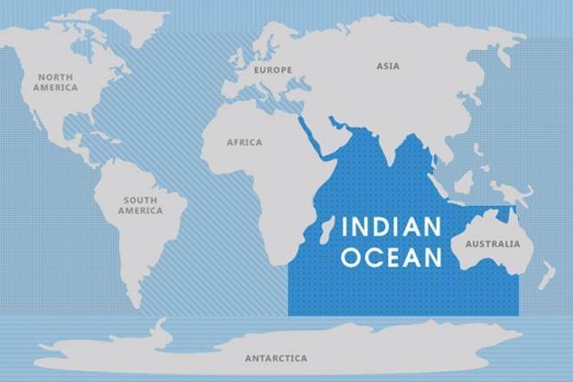
Figure: Indian Ocean

Slide 70
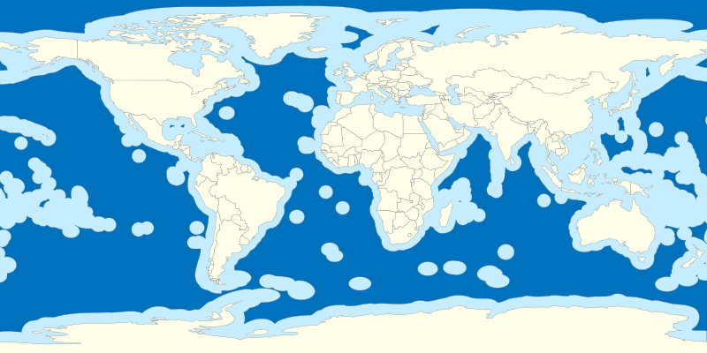
High seas
ABNJ
Notes:
https://www.oceanoculus.com/news-from-the-sea/migratory-marine-species-protection

Slide 71
Way forward
Climate change mitigation and adaptation plan – state level commitment and full scale implementation
Data and information sharing
IORA base on scientists and their specific fields
Technology transfer
Collaborative research on transboundary migration
Research on climate resistant varieties
MPAs and effective management of MPAs
Regional and global agreements – CMS - IRAN Declaration

Slide 72
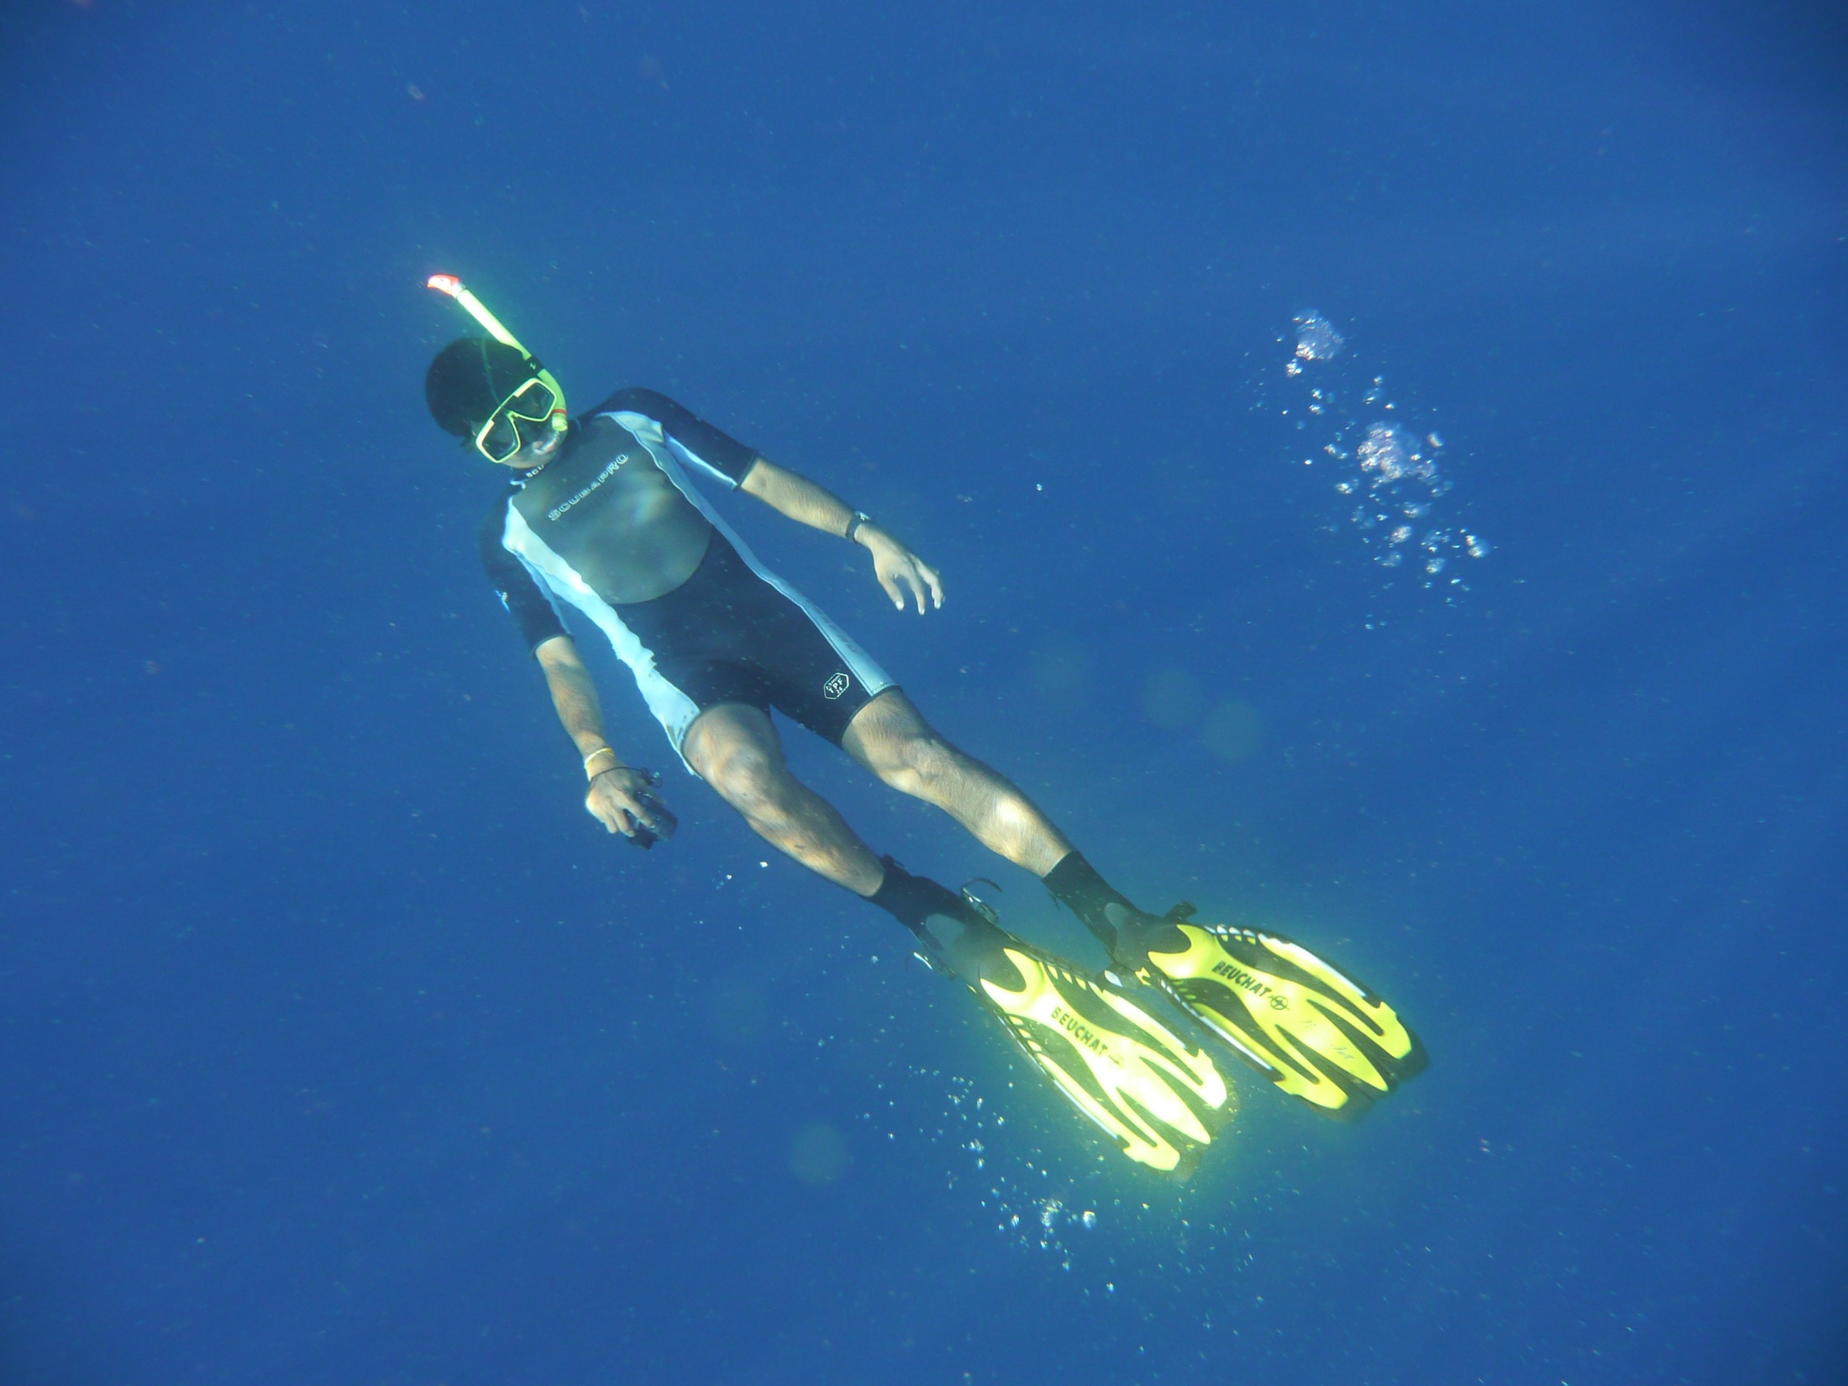
Thank you !
Notes:
72

